Slide 1
Taylor Ranch Survey
This is not intended to be a professional survey.
It is only intended to pass along family held knowledge about the boundaries of the Howard owned parcels of the Taylor Ranch.
Map overlays may not be exact. The main purpose is to document the corners and known survey data.
GPS coordinates were recorded using non-professional equipment.

Slide 2
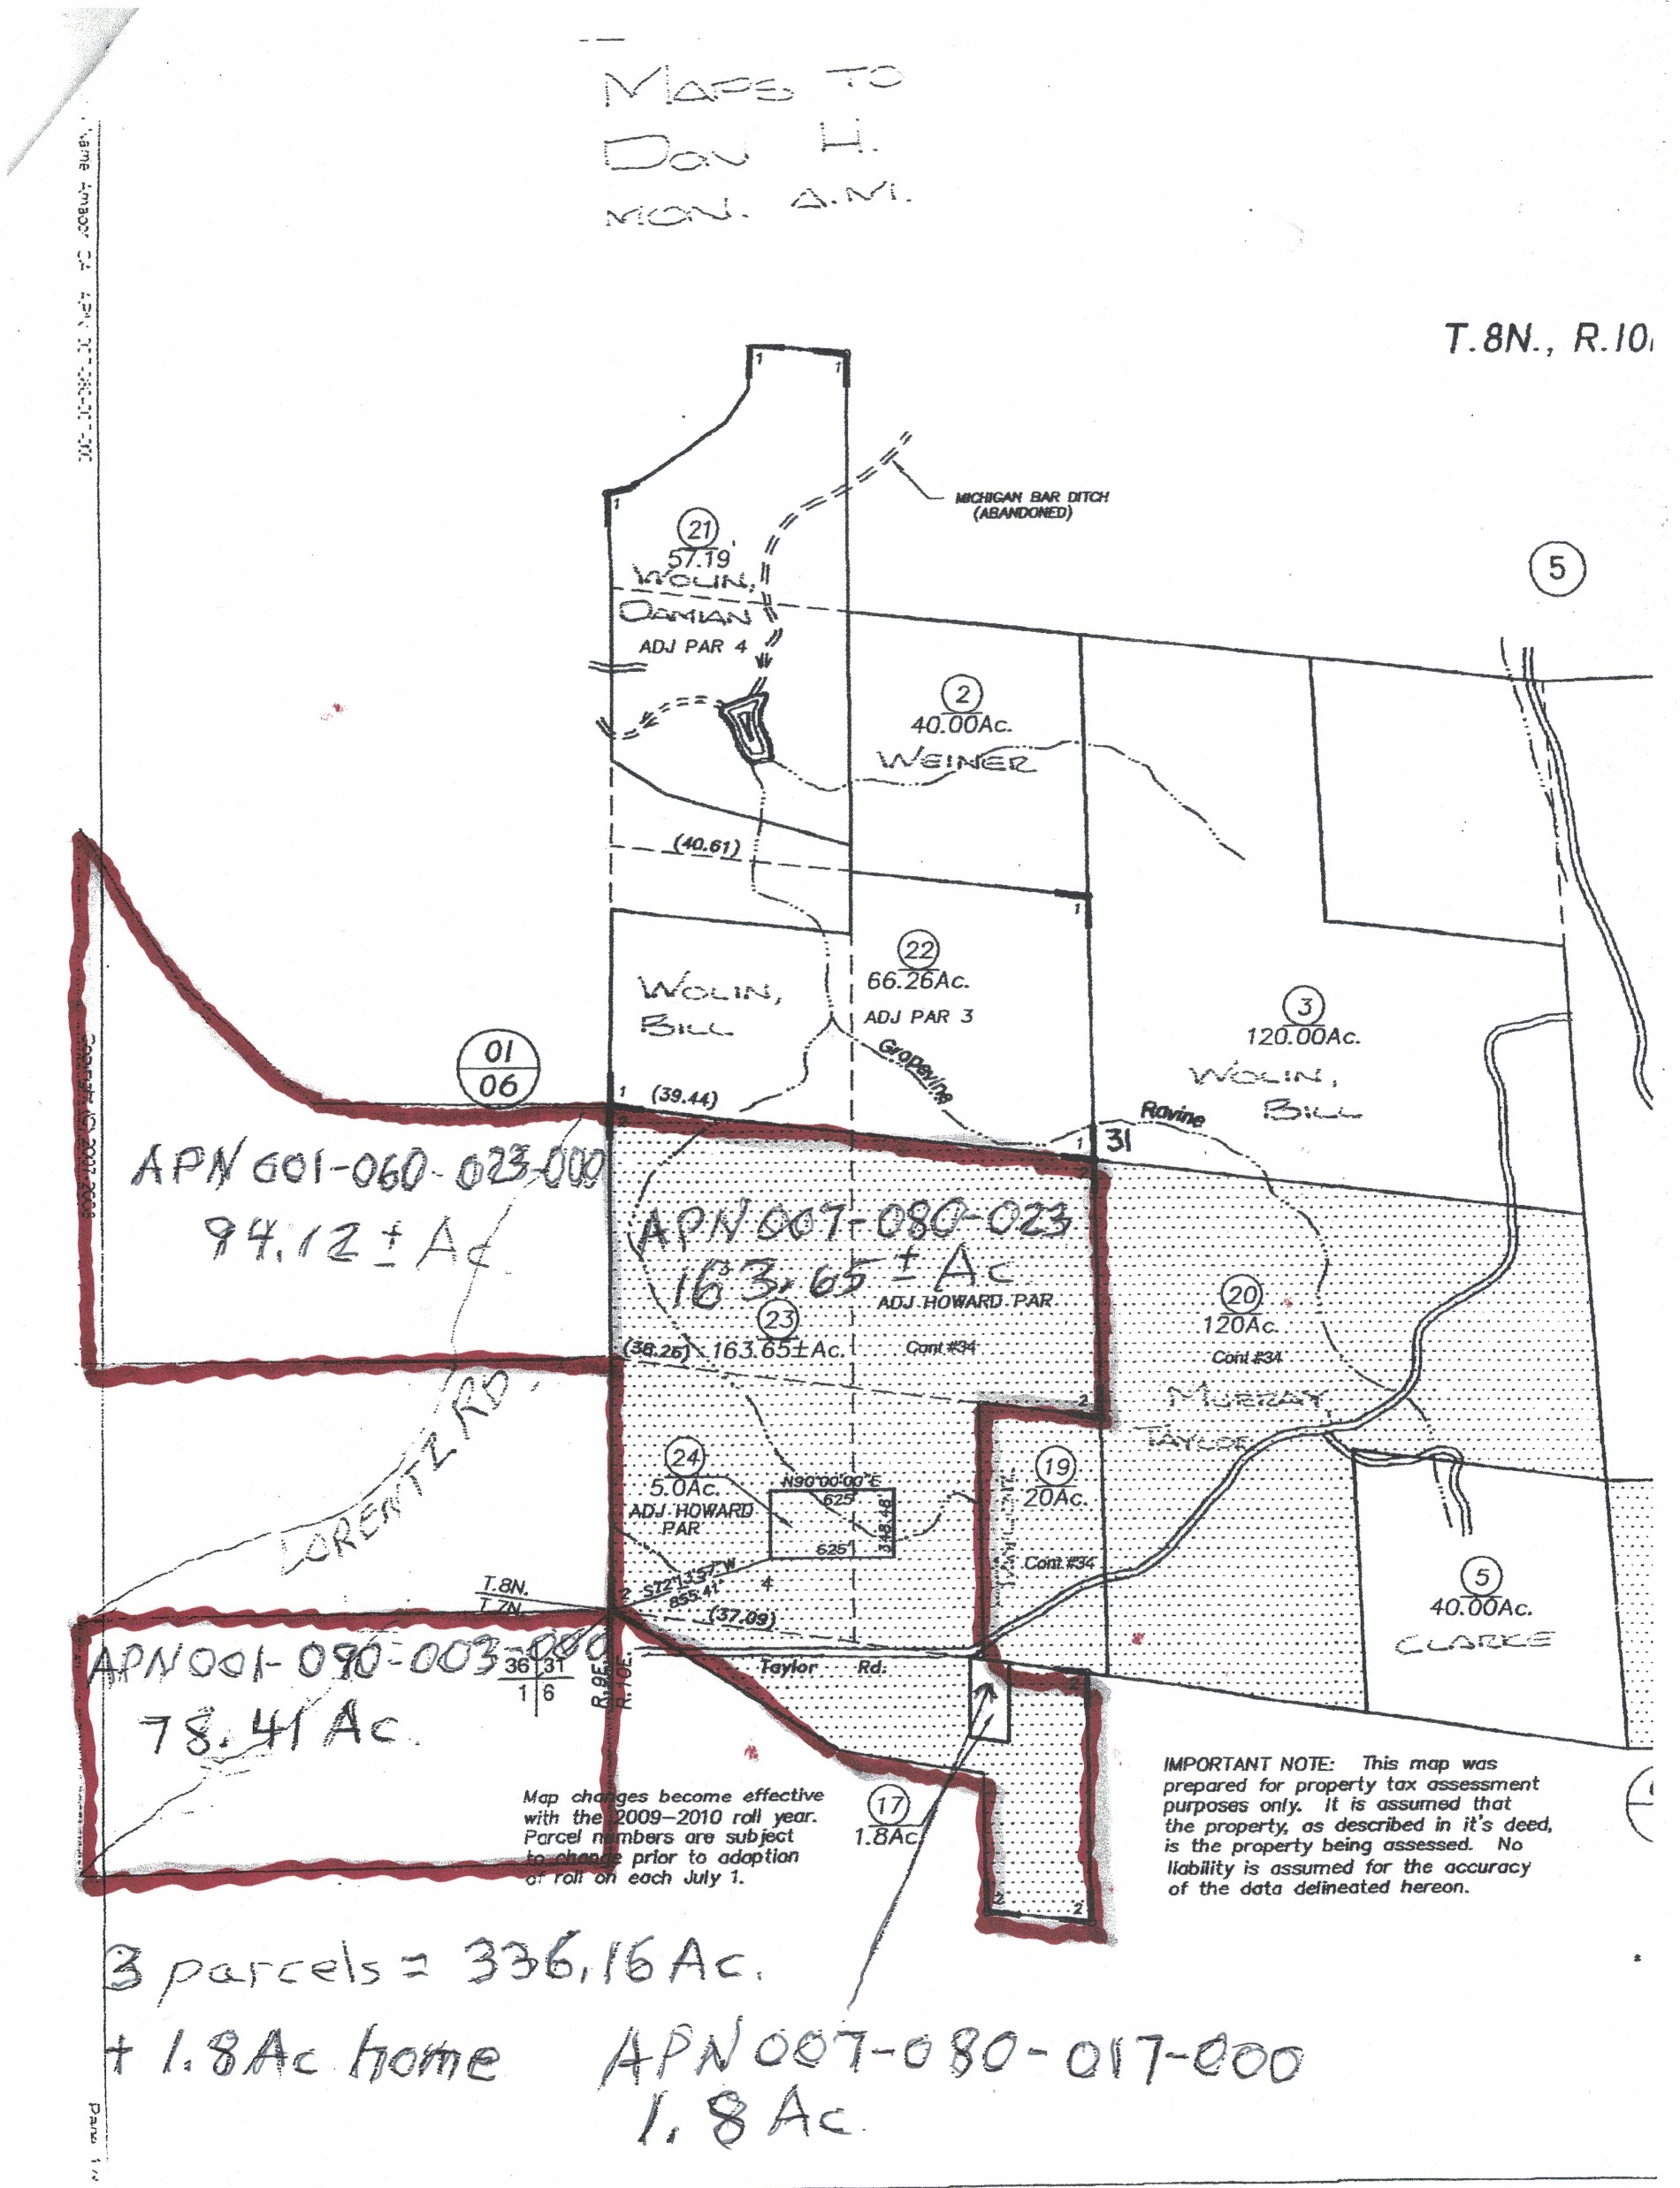
Taylor Ranch
Assessor’s Map
Howard owned parcels

Slide 3
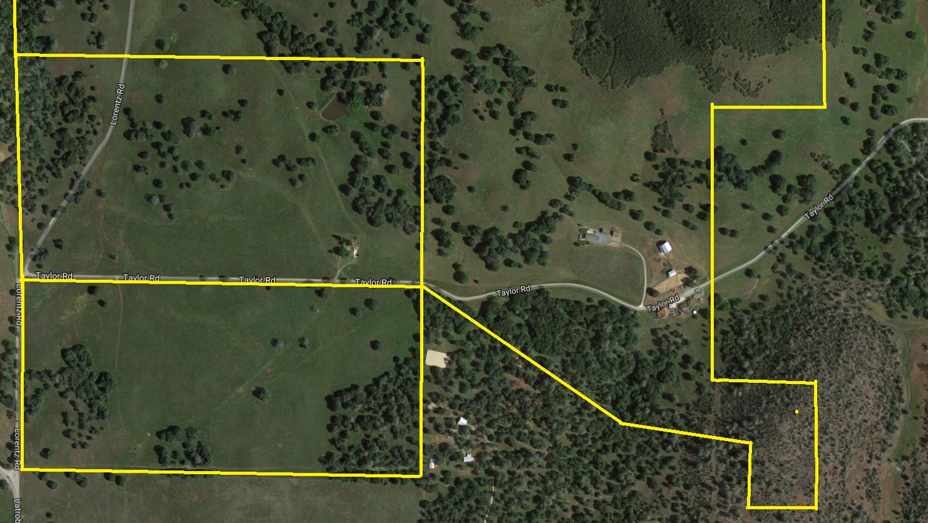
Where is Point F2?
J
I
F
E
Howard
Susan
F2
G
Susan
Q
H
Howard
P
O
Frenchy
K
R
L
S
Applegate
South Side
M
N

Slide 4
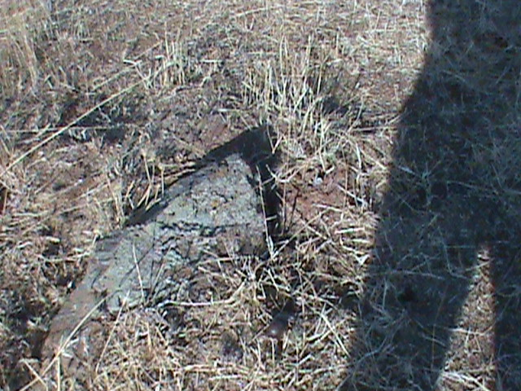
East Side F2
Point F2 is a survey stake located at 38.499210 North X 120.919719 West. It is on the property line between Howard and Susan.

Slide 5
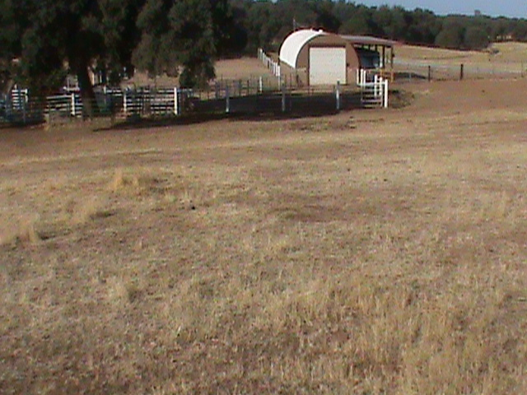
East Side F2
View from standing on the F2 survey stake.

Slide 6

Where is point F?
J
I
F
E
Howard
Susan
F2
G
Susan
Q
H
Howard
P
O
Frenchy
K
R
L
S
Applegate
South Side
M
N

Slide 7
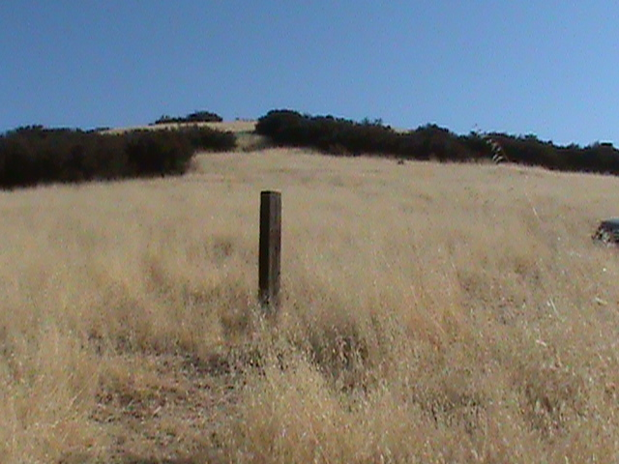
East Side F
Point F is marked by a post located at 38.501792 North X 120.919745 West. The point was determined by surveyor Matt Toma during an unofficial (unrecorded) survey in 2012.

Slide 8
Where is Point E?
J
I
F
E
Howard
Susan
F2
G
Susan
Q
H
Howard
P
O
Frenchy
K
R
L
S
Applegate
South Side
M
N

Slide 9
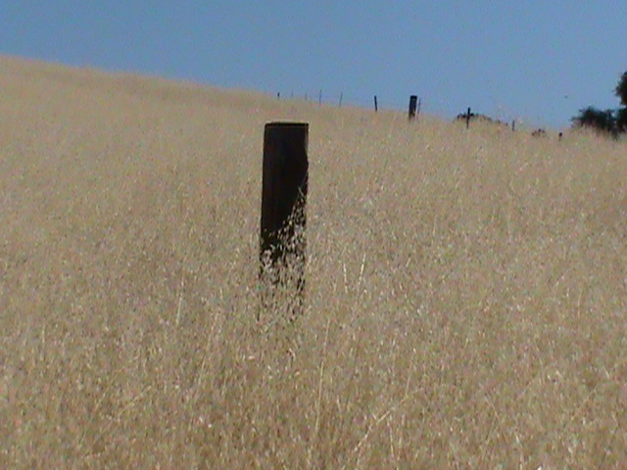
East Side E
Point E is marked by a post located at 38.501550 North X 120.917623 West. The point was determined by surveyor Matt Toma during an unofficial (unrecorded) survey in 2012.

Slide 10
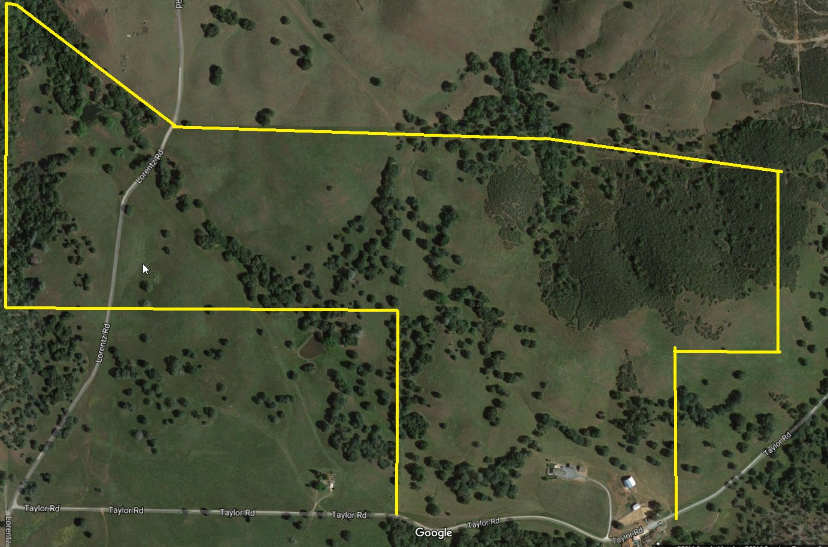

North Side – Where is Point D?
A
Wolin
B
C
D
Howard
J
I
F
E
Susan
Susan
F2
H
G

Slide 11
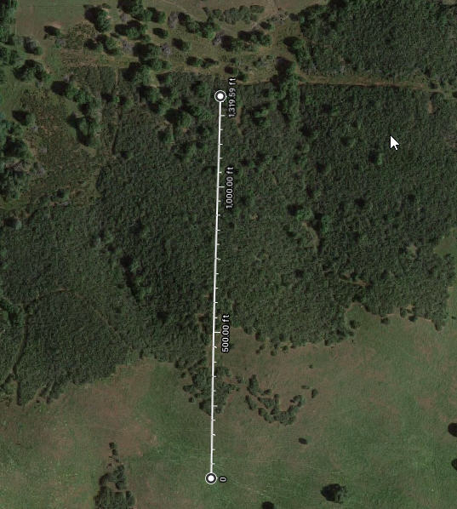
North Side D
D
Point D is 1320 feet North of Point E.
Point D is located at 38.505236 North X 120.919565 West.
E

Slide 12

North Side – Points A, B, B2, C, D
A
Wolin
B
B2
C
D
Howard
J
I
F
E
Susan
Susan
F2
H
G

Slide 13
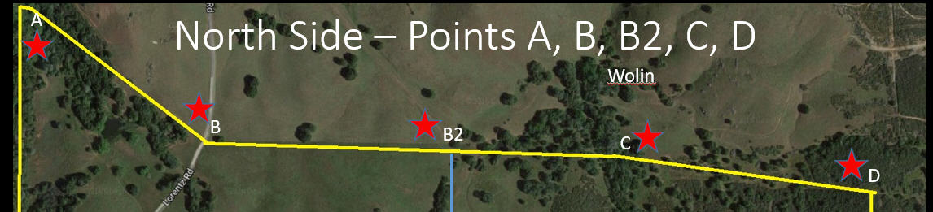
For the entire North side, as of today (9/5/2016), the fence line follows the property line. Points C and D were adjusted by the Howard / Wolin Boundary Line Agreement of 5/28/2014. This agreement appears later in this slide show.

Slide 14
North Side – Where is Point B2?
A
Wolin
B
B2
C
D
Howard
J
I
Howard
F
E
Susan
Susan
F2
H
G

Slide 15
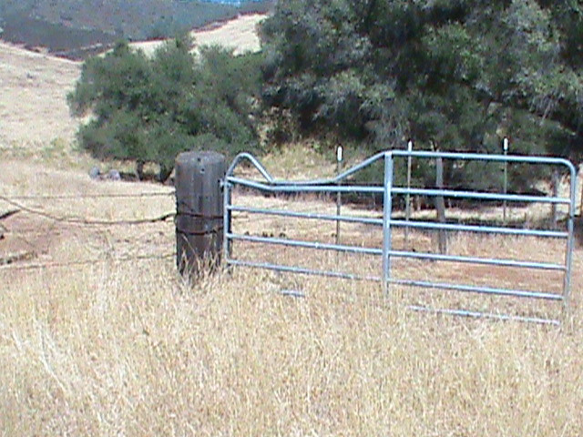
Point B2
Point B2 is 2640 feet North of Point H.
It is on the fence line that runs North from Point H to the Wolin border.
Point B2 is located at 38.506085 North X 120.926341 West.

Slide 16
North Side – Where is Point B
A
Wolin
B
B2
C
D
Howard
J
I
F
E
Susan
Susan
F2
H
G

Slide 17
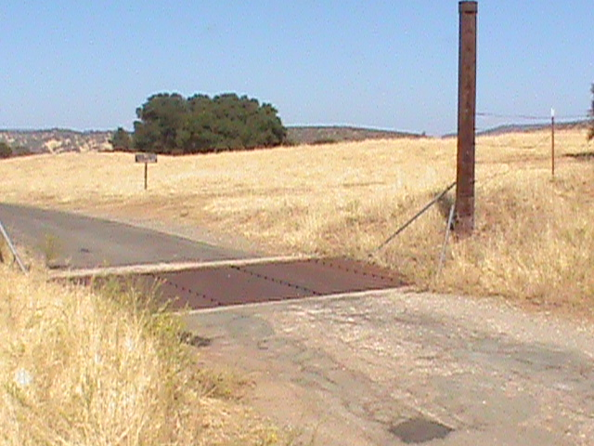
Point B
Point B is at the cattle guard on Lorentz Road at the Howard / Wolin border.
Point B is located at 38.506138 North X 120.931669 West.

Slide 18
North Side – Where is Point A?
A
Wolin
B
C
D
Howard
J
I
F
E
Susan
Susan
F2
H
G

Slide 19
North Side A
Point A was recorded when Harper Taylor gave 10 acres to the Wolin family many years ago.
Point A is located at 38.509617 North X 120.935414 West.
Surveys and agreements are available at the County Maps Office and the Country Recorders Office respectively.

Slide 20
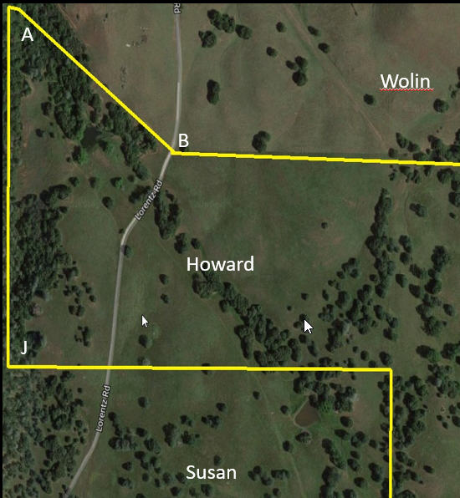
The fence between Point A and Point J was constructed to the East of the actual property line. Only a new survey can determine the actual property line, but Howard’s do own property West of the fence.

Slide 21
West Side – Where is Point J?
A
Wolin
B
C
D
Howard
J
I
F
E
Susan
Susan
F2
H
G

Slide 22
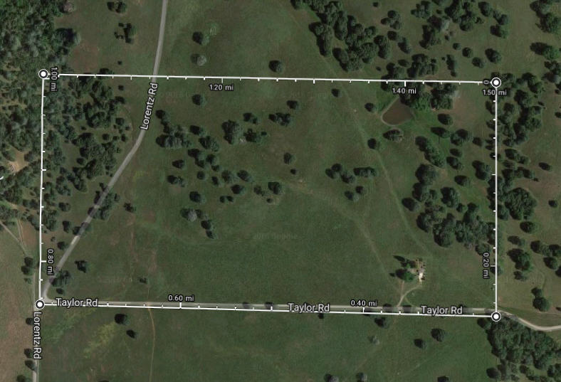
West Side J
Point J is 2640 feet West of Point I.
It is located at 38.502568 North X 120.935501 West.
J
I
Susan
Q
H

Slide 23
Where is Point I?
A
Wolin
B
B2
C
D
Howard
J
I
F
E
Susan
Susan
F2
H
G

Slide 24
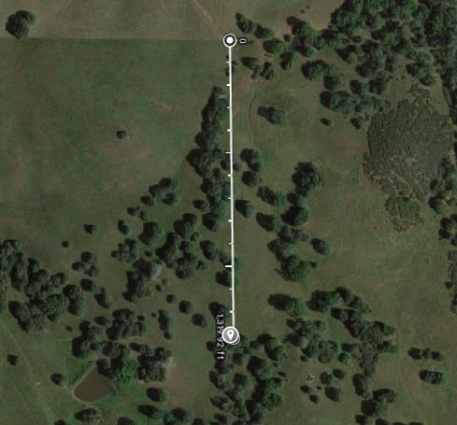
Point I
Point I is on the fence line half way between point H and the Wolin border at Point B2. It is 1320 feet from Point H and 1320 feet from Point B2.
It is located at 38.502524 North X 120.926200 West.

Slide 25
Where is Point Q?
J
I
F
E
Howard
Susan
F2
G
Susan
Q
H
Howard
P
O
Frenchy
K
R
L
S
Applegate
South Side
M
N

Slide 26
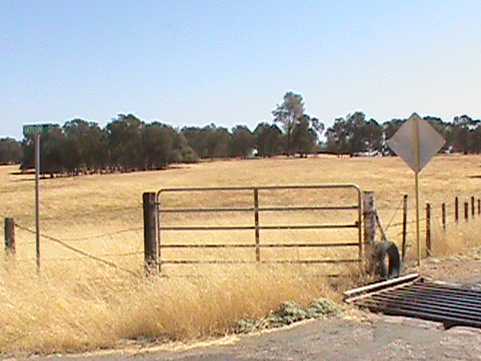
West Side Q
Point Q is near the junction of Lorentz Road and Taylor Road.
It is located at 38.498863 North X 120.935518 West.

Slide 27
Where is Point R?
J
I
F
E
Howard
Susan
F2
G
Susan
Q
H
Howard
P
O
Frenchy
K
R
L
S
Applegate
South Side
M
N

Slide 28
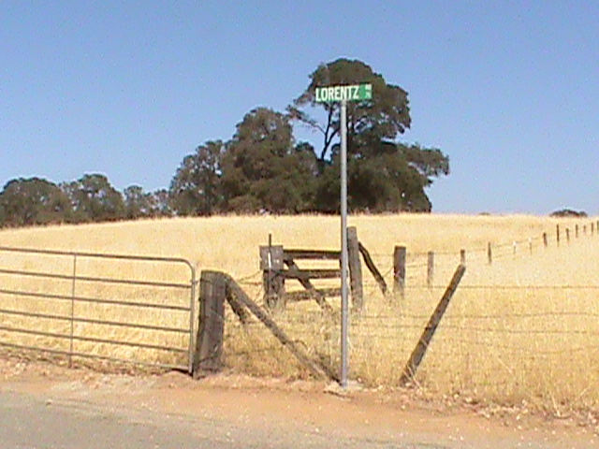
South West Point R
Point R is near the junction of Lorentz Road and Latrobe Road.
It is located at 38.495426 North X 120.935623 West.

Slide 29
Where is Point H?
J
I
F
E
Howard
Susan
F2
G
Susan
Q
H
Howard
P
O
Frenchy
K
R
L
S
Applegate
South Side
M
N

Slide 30
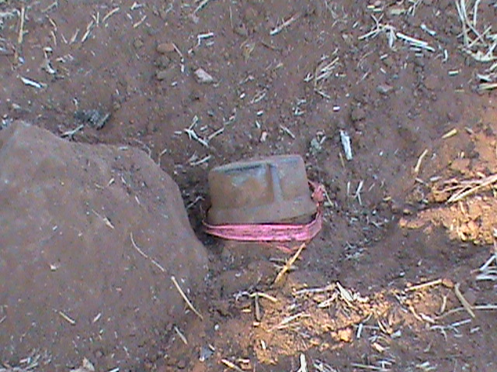
Point H
Point H is near the cattle guard on Taylor Road 0.5 miles from Lorentz Road.
It is marked by a Township and Range Corner marker located at 38.498725 North X 120.926311 West.

Slide 31
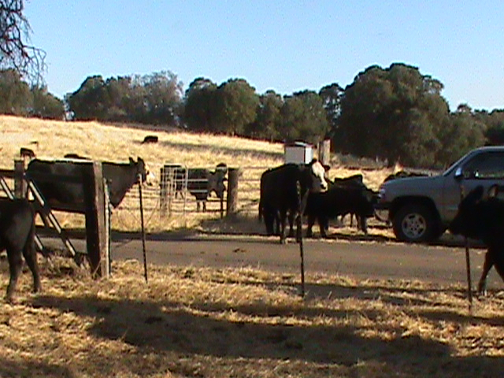
View from standing on the Township and Range marker

Slide 32
Where is Point S?
J
I
F
E
Howard
Susan
F2
G
Susan
Q
H
Howard
P
O
Frenchy
K
R
L
S
Applegate
South Side
M
N

Slide 33
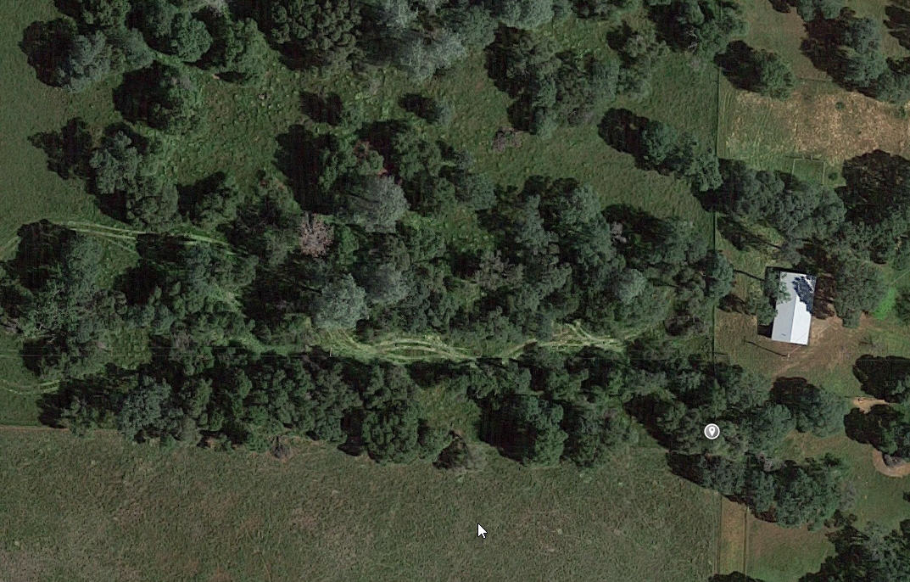
Point S
Point S is located at 38.495219 North X 120.926315 West.
“The 80” is fenced properly and the fence matches the property lines on all 4 sides.

Slide 34
Where is Point K?
J
I
F
E
Howard
Susan
F2
G
Susan
Q
H
Howard
P
O
Frenchy
K
R
L
S
Applegate
South Side
M
N

Slide 35
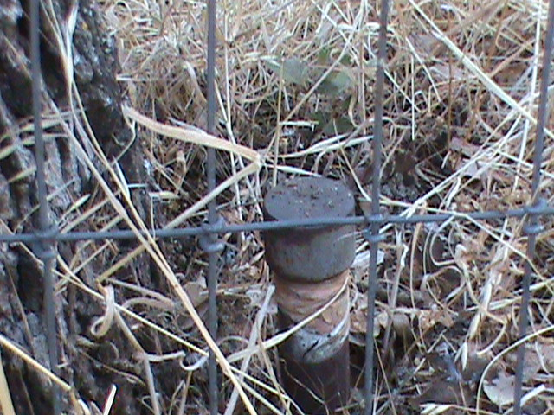
Point K
Point K is marked by a survey stake located at 38.496729 North X 120.922224 West.

Slide 36
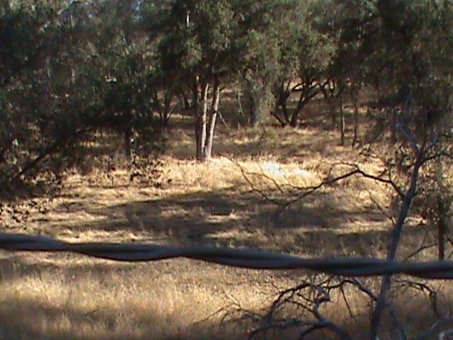
View from the Point K survey stake

Slide 37
Where is Point L?
J
I
F
E
Howard
Susan
F2
G
Susan
Q
H
Howard
P
O
Frenchy
K
R
L
S
Applegate
South Side
M
N

Slide 38
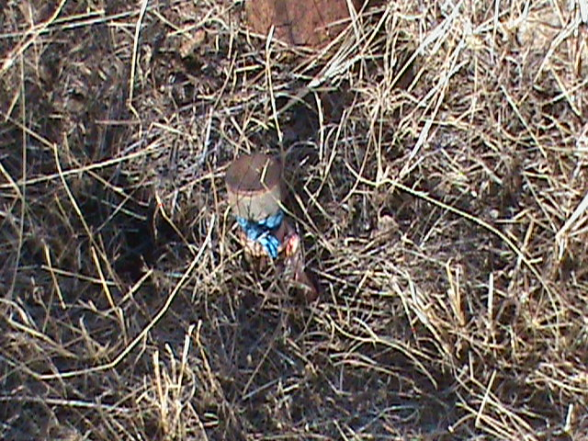
Point L
Point L is marked by a survey stake located at 38.496431 North X 120.919599 West.
The fence through Points H, K, L, M, N matches the actual property lines.

Slide 39
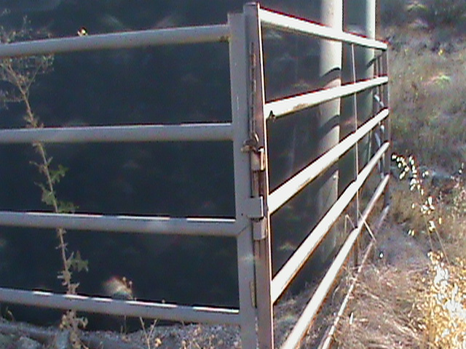
Point L
Point L is 10 feet West of the twin water towers.

Slide 40
Where is Point M?
J
I
F
E
Howard
Susan
F2
G
Susan
Q
H
Howard
P
O
Frenchy
K
R
L
S
Applegate
South Side
M
N

Slide 41
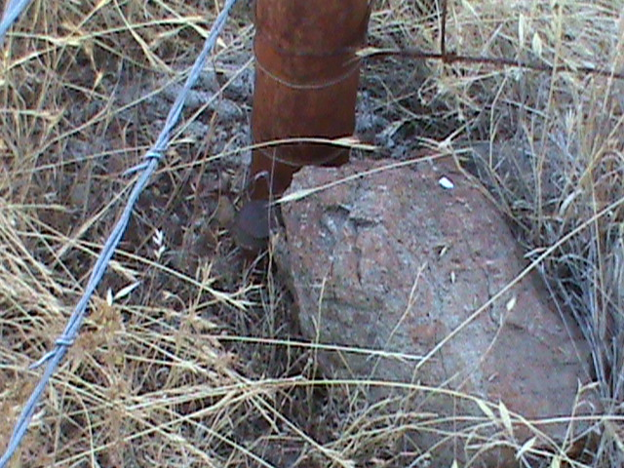
Point M
Point M is marked by a survey stake located at 38.494498 North X 120.919573 West.

Slide 42
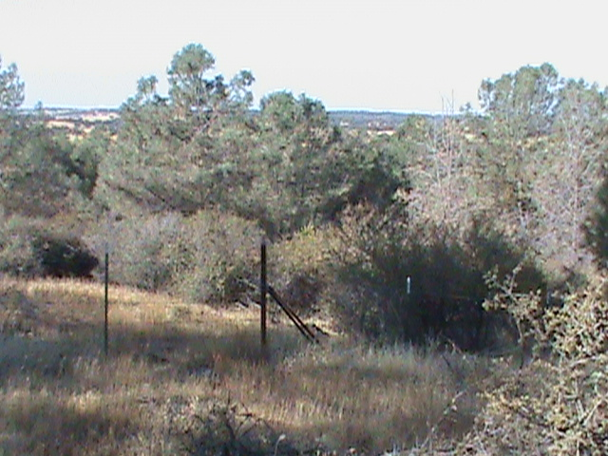
View of the Point M survey stake corner

Slide 43
Where is Point N?
J
I
F
E
Howard
Susan
F2
G
Susan
Q
H
Howard
P
O
Frenchy
K
R
L
S
Applegate
South Side
M
N

Slide 44
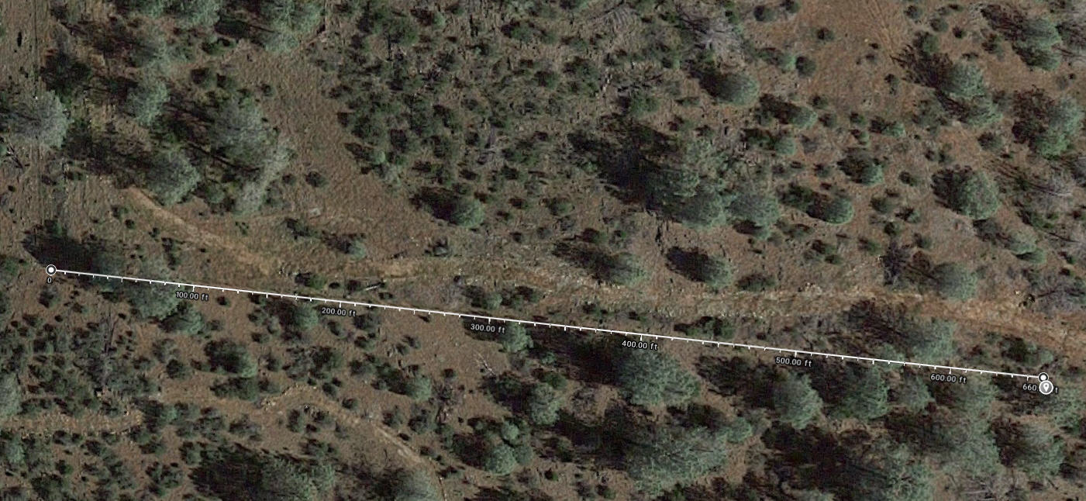
Point N is 660 feet East of Point M.
It is located at 38.494252 North X 120.917266 West.
This line below extends from Point M to Point N.

Slide 45
Where is Point O?
J
I
F
E
Howard
Susan
F2
G
Susan
Q
H
Howard
P
O
Frenchy
K
R
L
S
Applegate
South Side
M
N

Slide 46
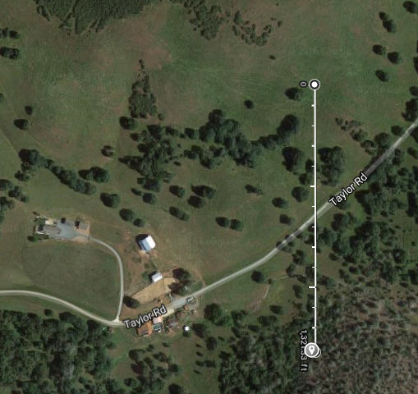
Point O
Point O is 1320 feet South of Point E.
This map shows a line between Point E and Point O.
It is located at 38.497971 North X 120.917838 West.

Slide 47
Where is Point P?
J
I
F
E
Howard
Susan
F2
G
Susan
Q
H
Howard
P
O
Frenchy
K
R
L
S
Applegate
South Side
M
N

Slide 48
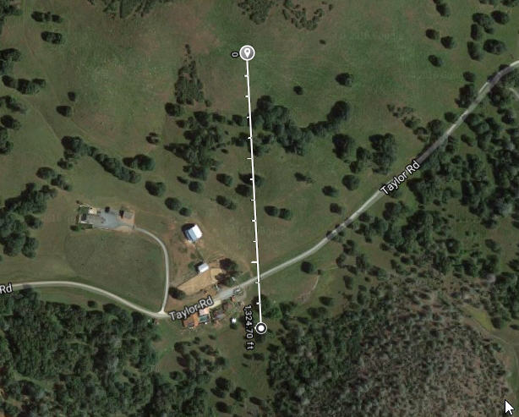
Point P
Point P is 1320 feet South of Point F.
This map shows a line between Point F and Point P.
It is located at 38.498246 North X 120.919590 West.

Slide 49
Where is Point G?
J
I
F
E
Howard
Susan
F2
G
Susan
Q
H
Howard
P
O
Frenchy
K
R
L
S
Applegate
South Side
M
N

Slide 50
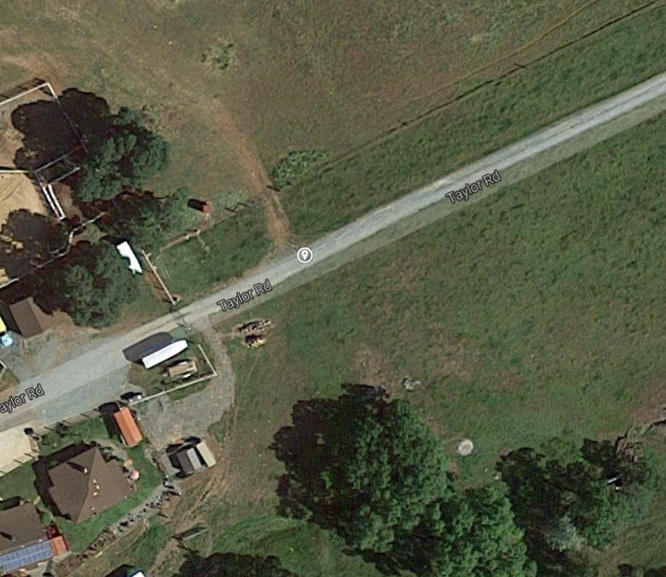
Point G
Point G is point at which the property line between Points P and F crosses Taylor Road. It is located at 38.498815 North X 120.919665 West.

Slide 51
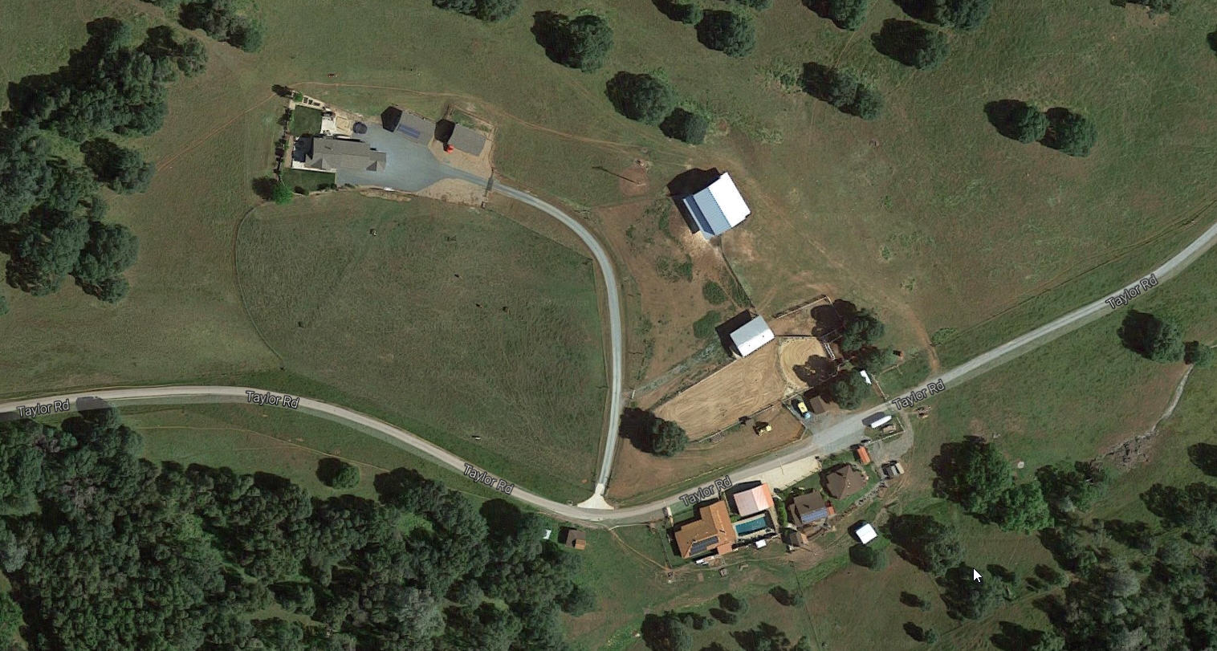

Slide 52
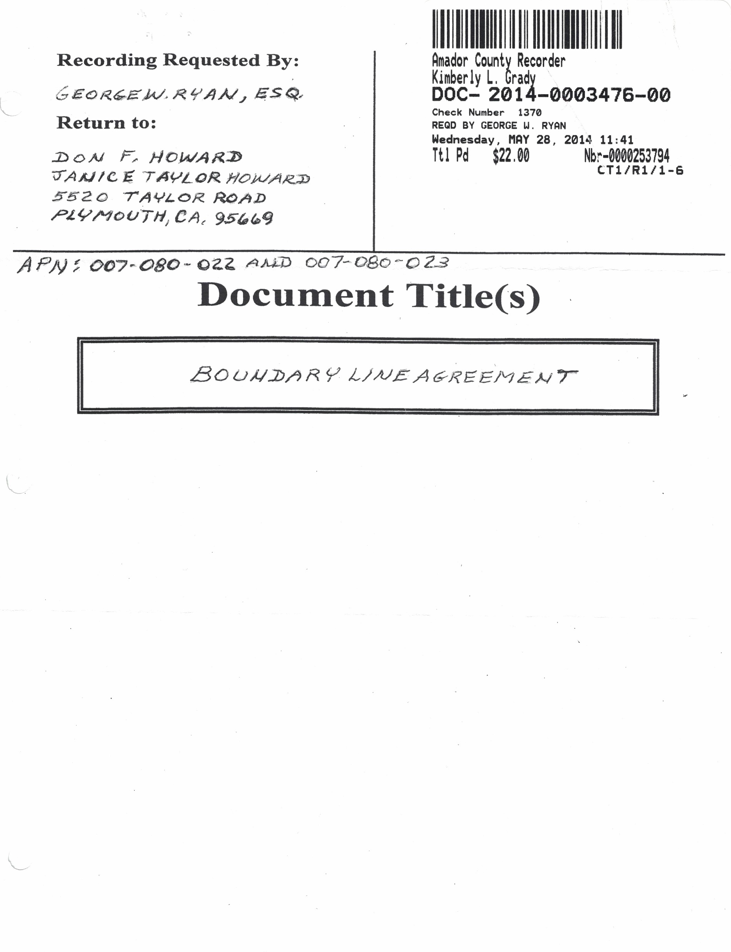
Howard / Wolin Boundary Line Agreement of 5/28/2014

Slide 53
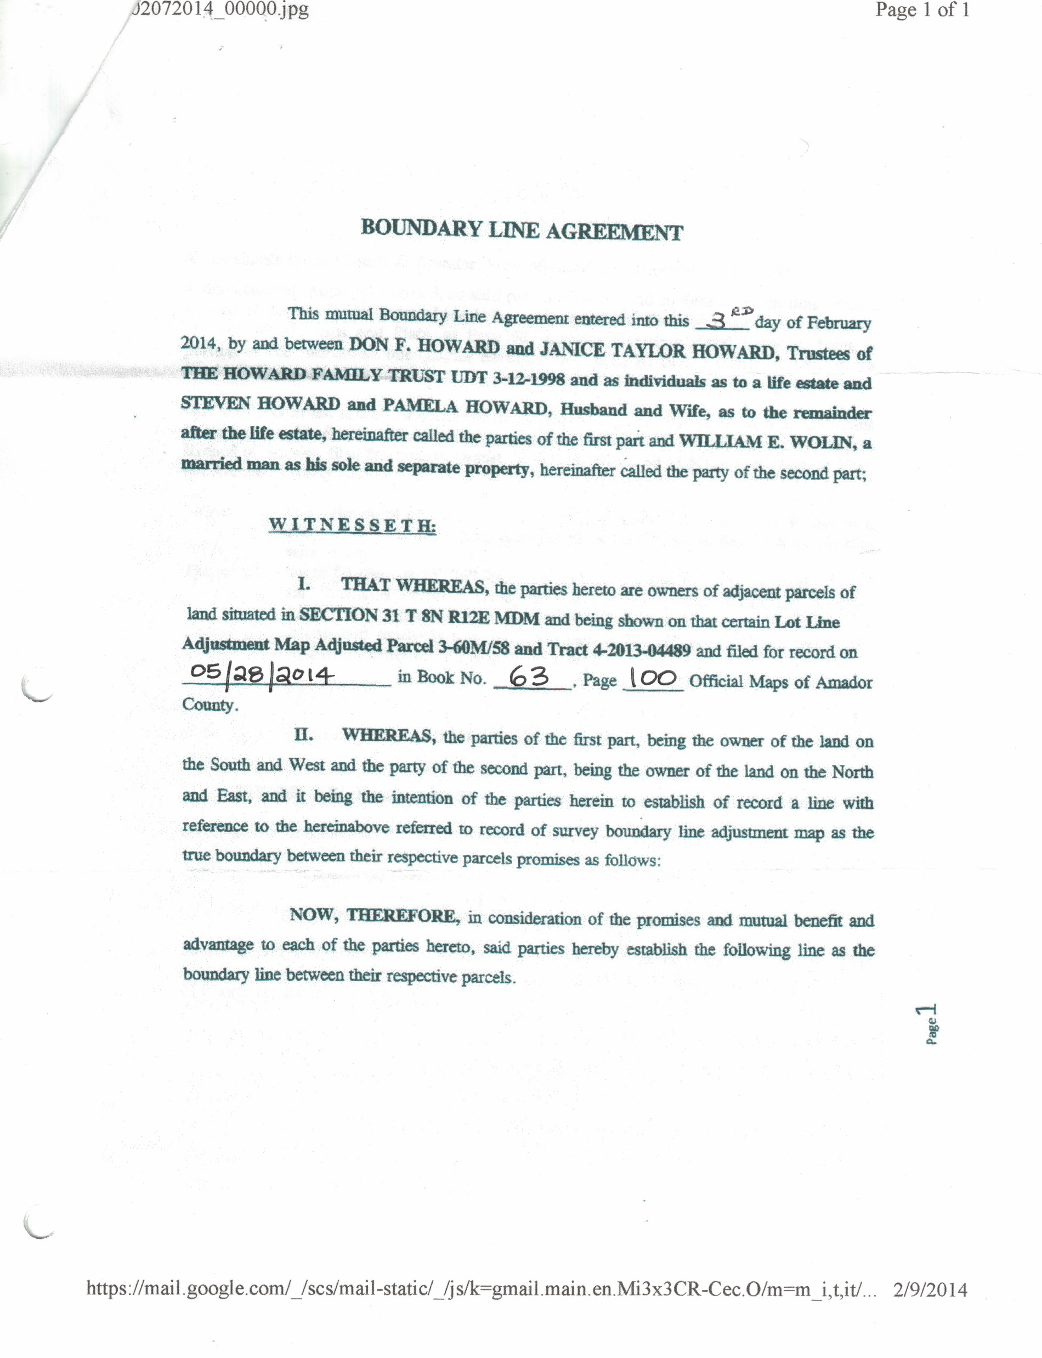

Slide 54
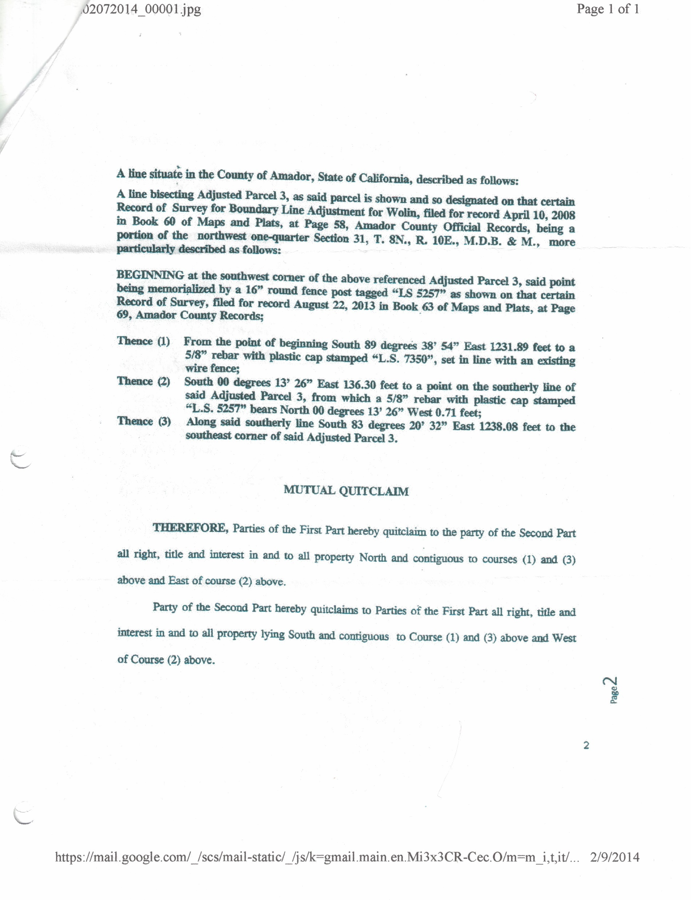

Slide 55
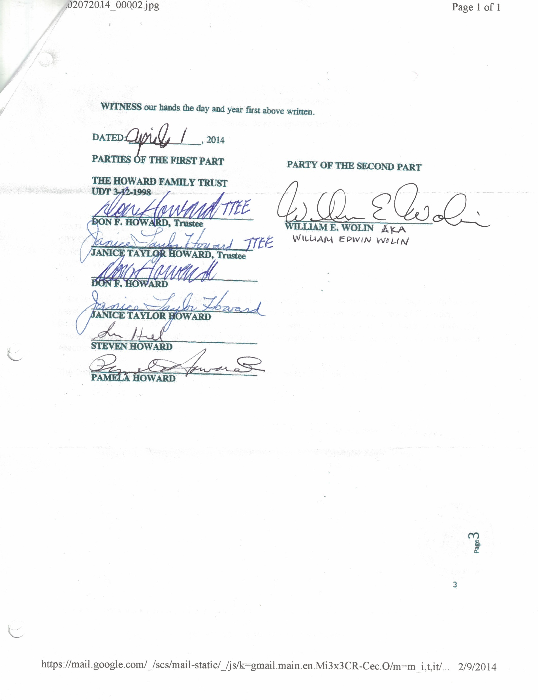

Slide 56
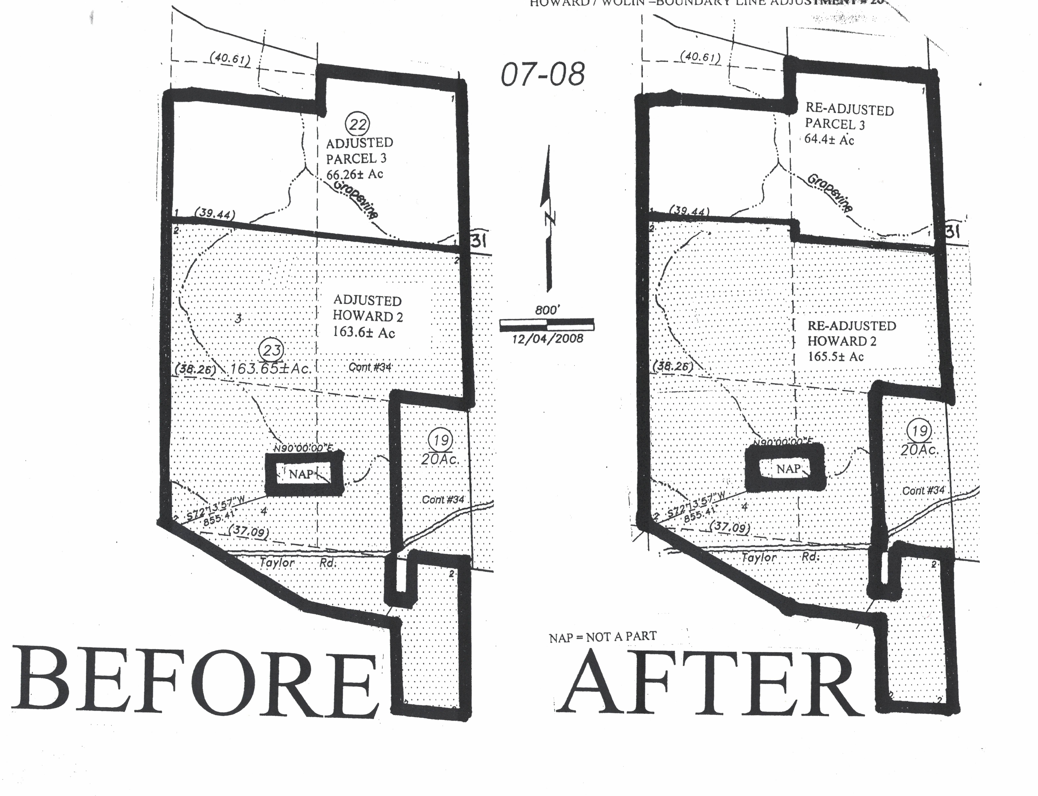

Slide 57
September 2019 Survey
In 2019, Steve and Pam Howard paid Toma and Associates, Inc. to survey and record the property lines connecting points O, P, G, F, E, D and the property lines connecting points H, I, J. These lines separate the ranch from property owned by Susan Taylor.
The lines were marked with T posts. Each T post is located one foot on our side of the actual property line. One foot from each T post is a survey monument (driven rebar) marking the actual boundary line.

Slide 58
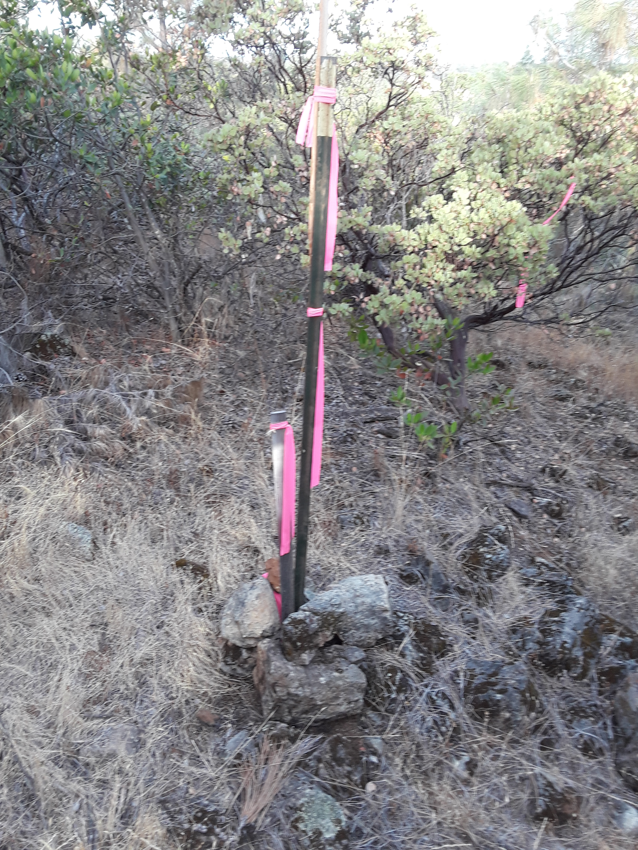
Point O was located at Lat 38.49785, Long -120.91755.

Slide 59
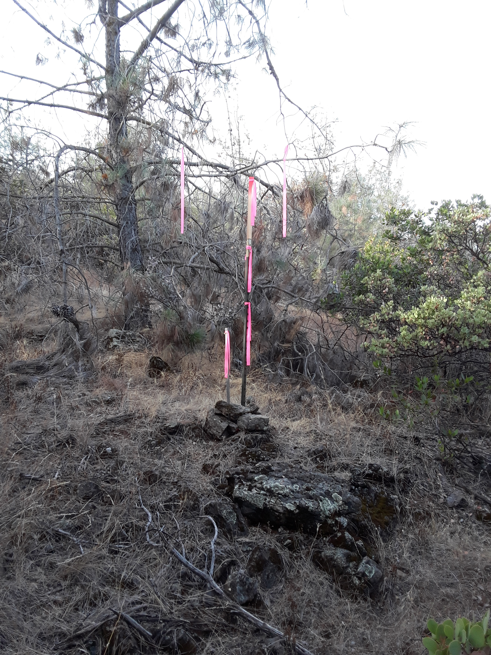
Point O

Slide 60
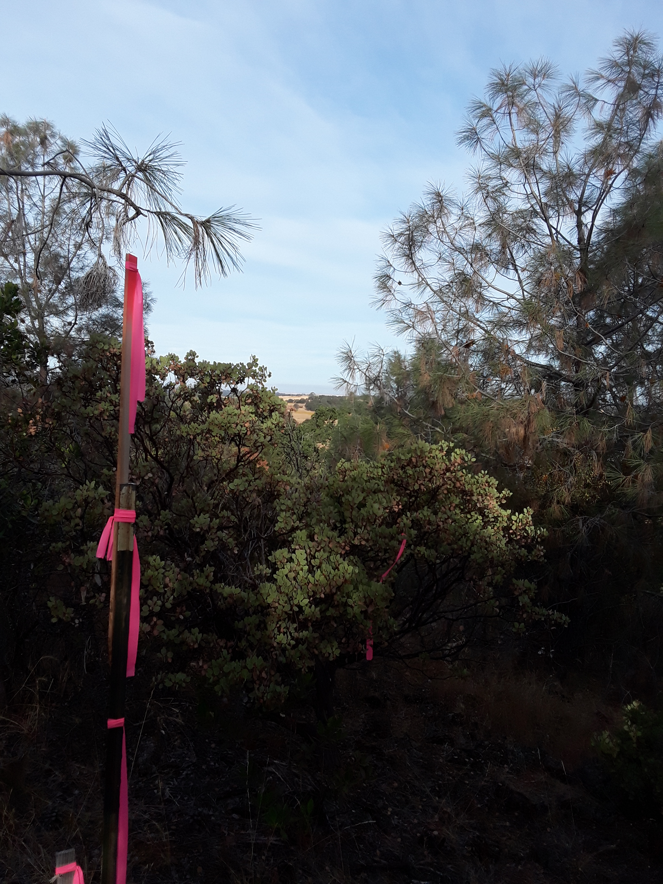
Point O

Slide 61
Line H, I, J
Point H is the township and range marker near the first cattle guard. See earlier slides.
Point I is near a west gate of the “bull field”. Lat 38.50236, Long -120.92633.
Point J is about 25 feet west of Lat 38.50262, Long -120.93558
The following pictures follow the T post marking of line H,I,J.

Slide 62
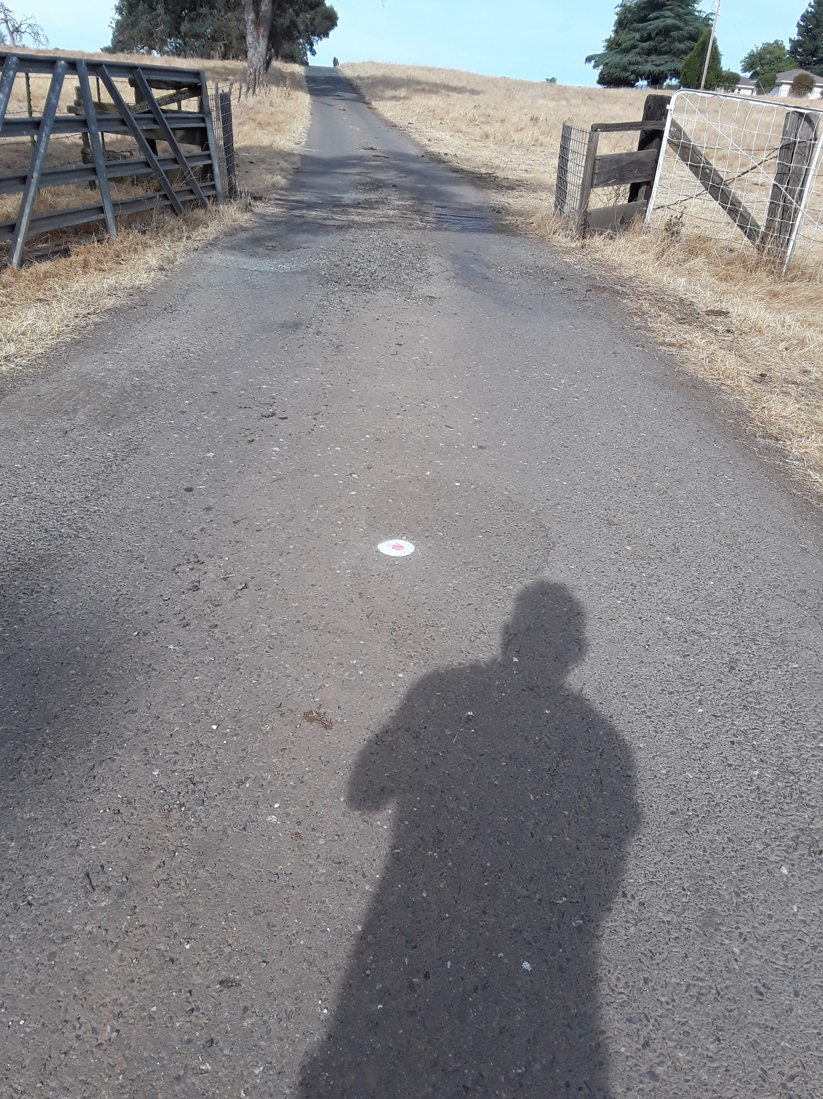

Slide 63
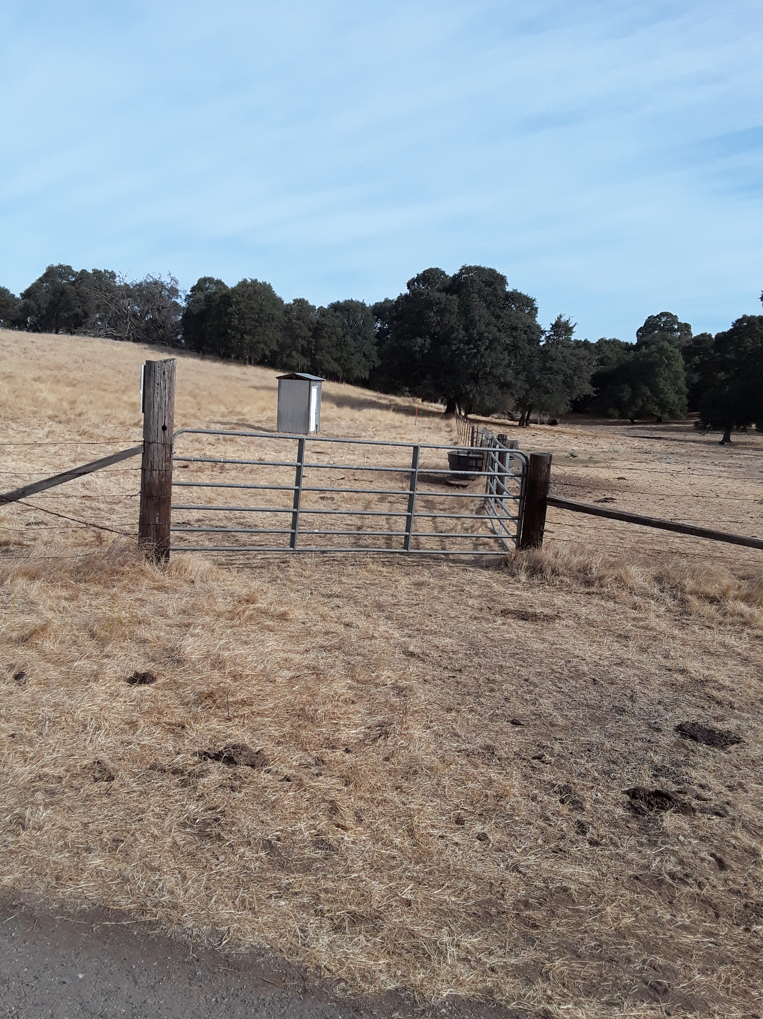

Slide 64
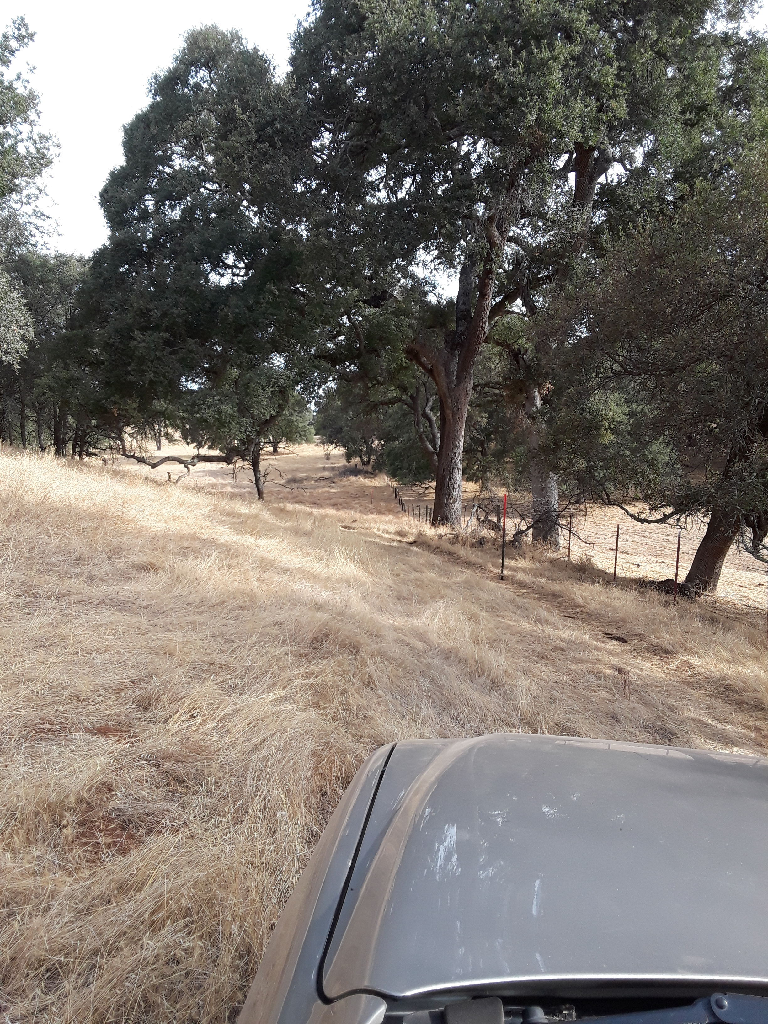

Slide 65
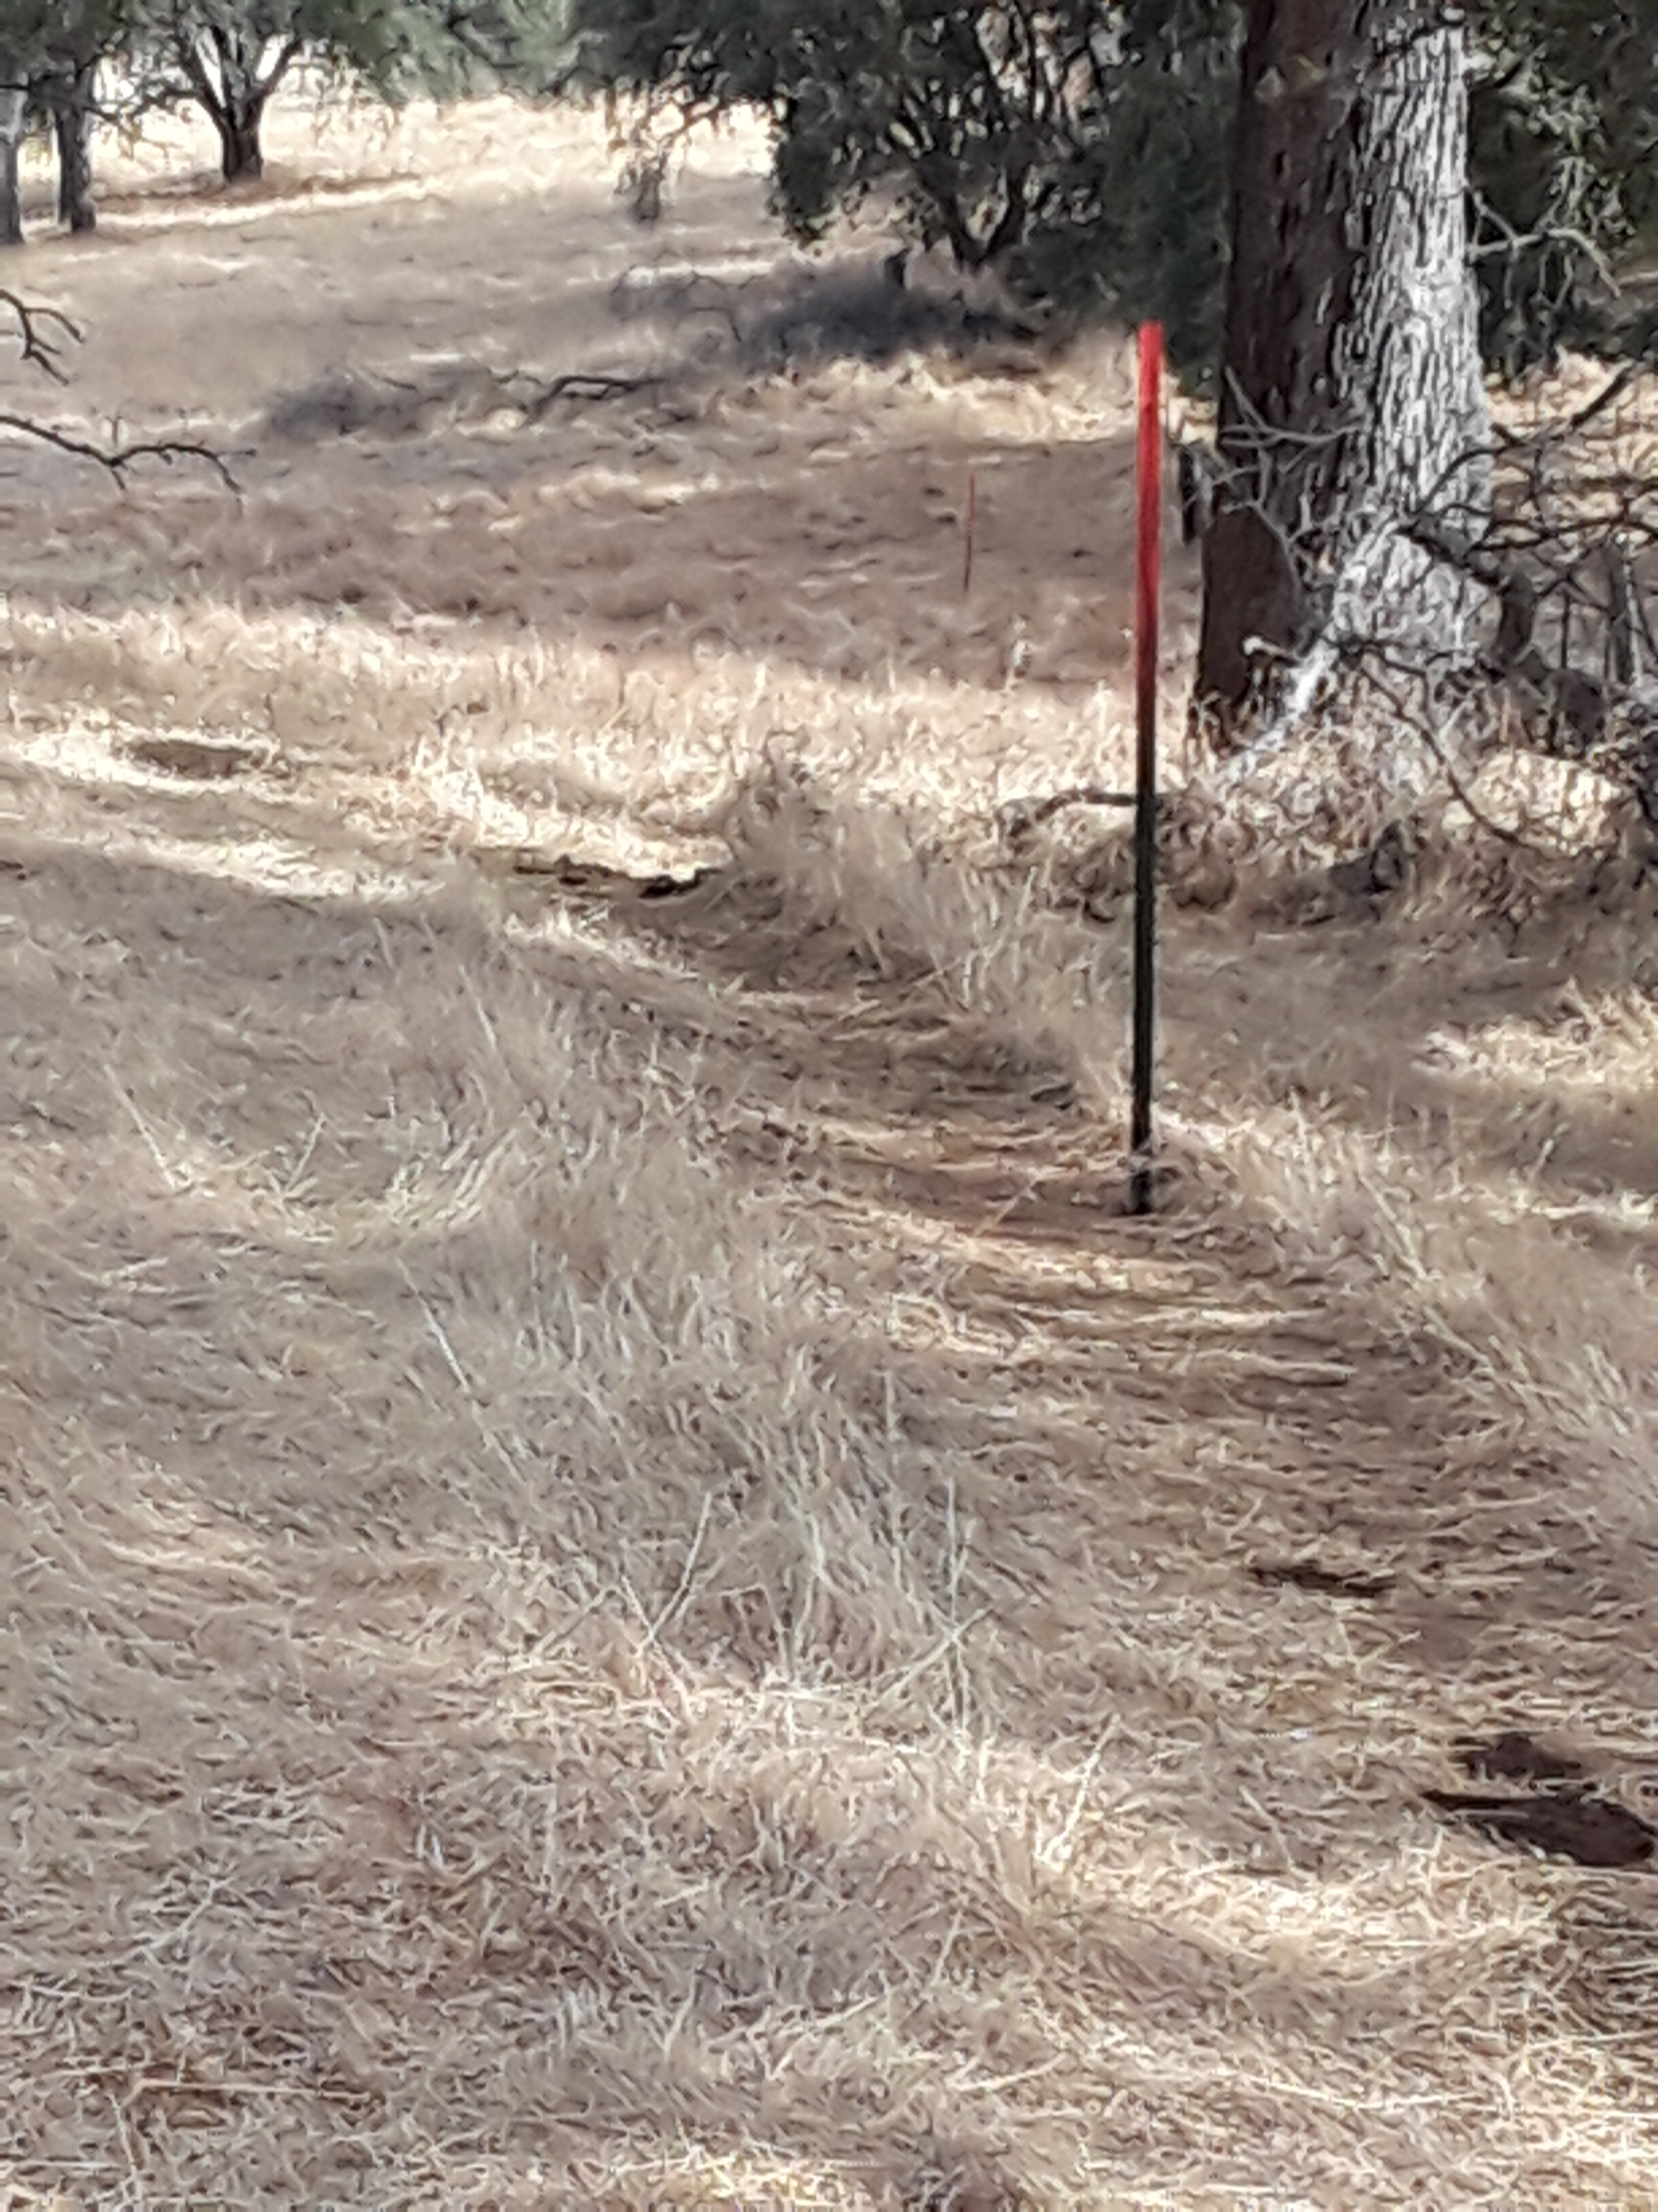

Slide 66
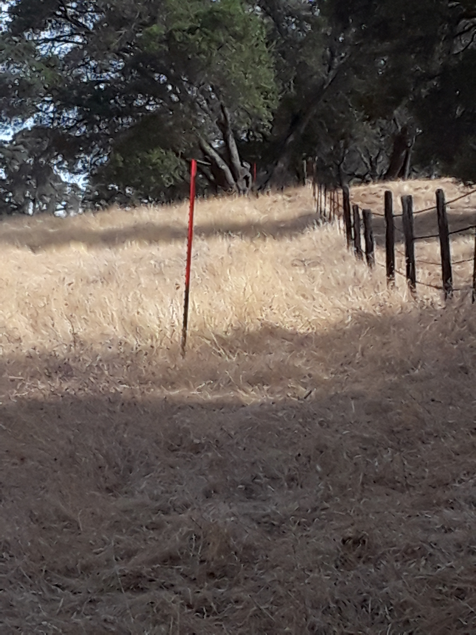

Slide 67
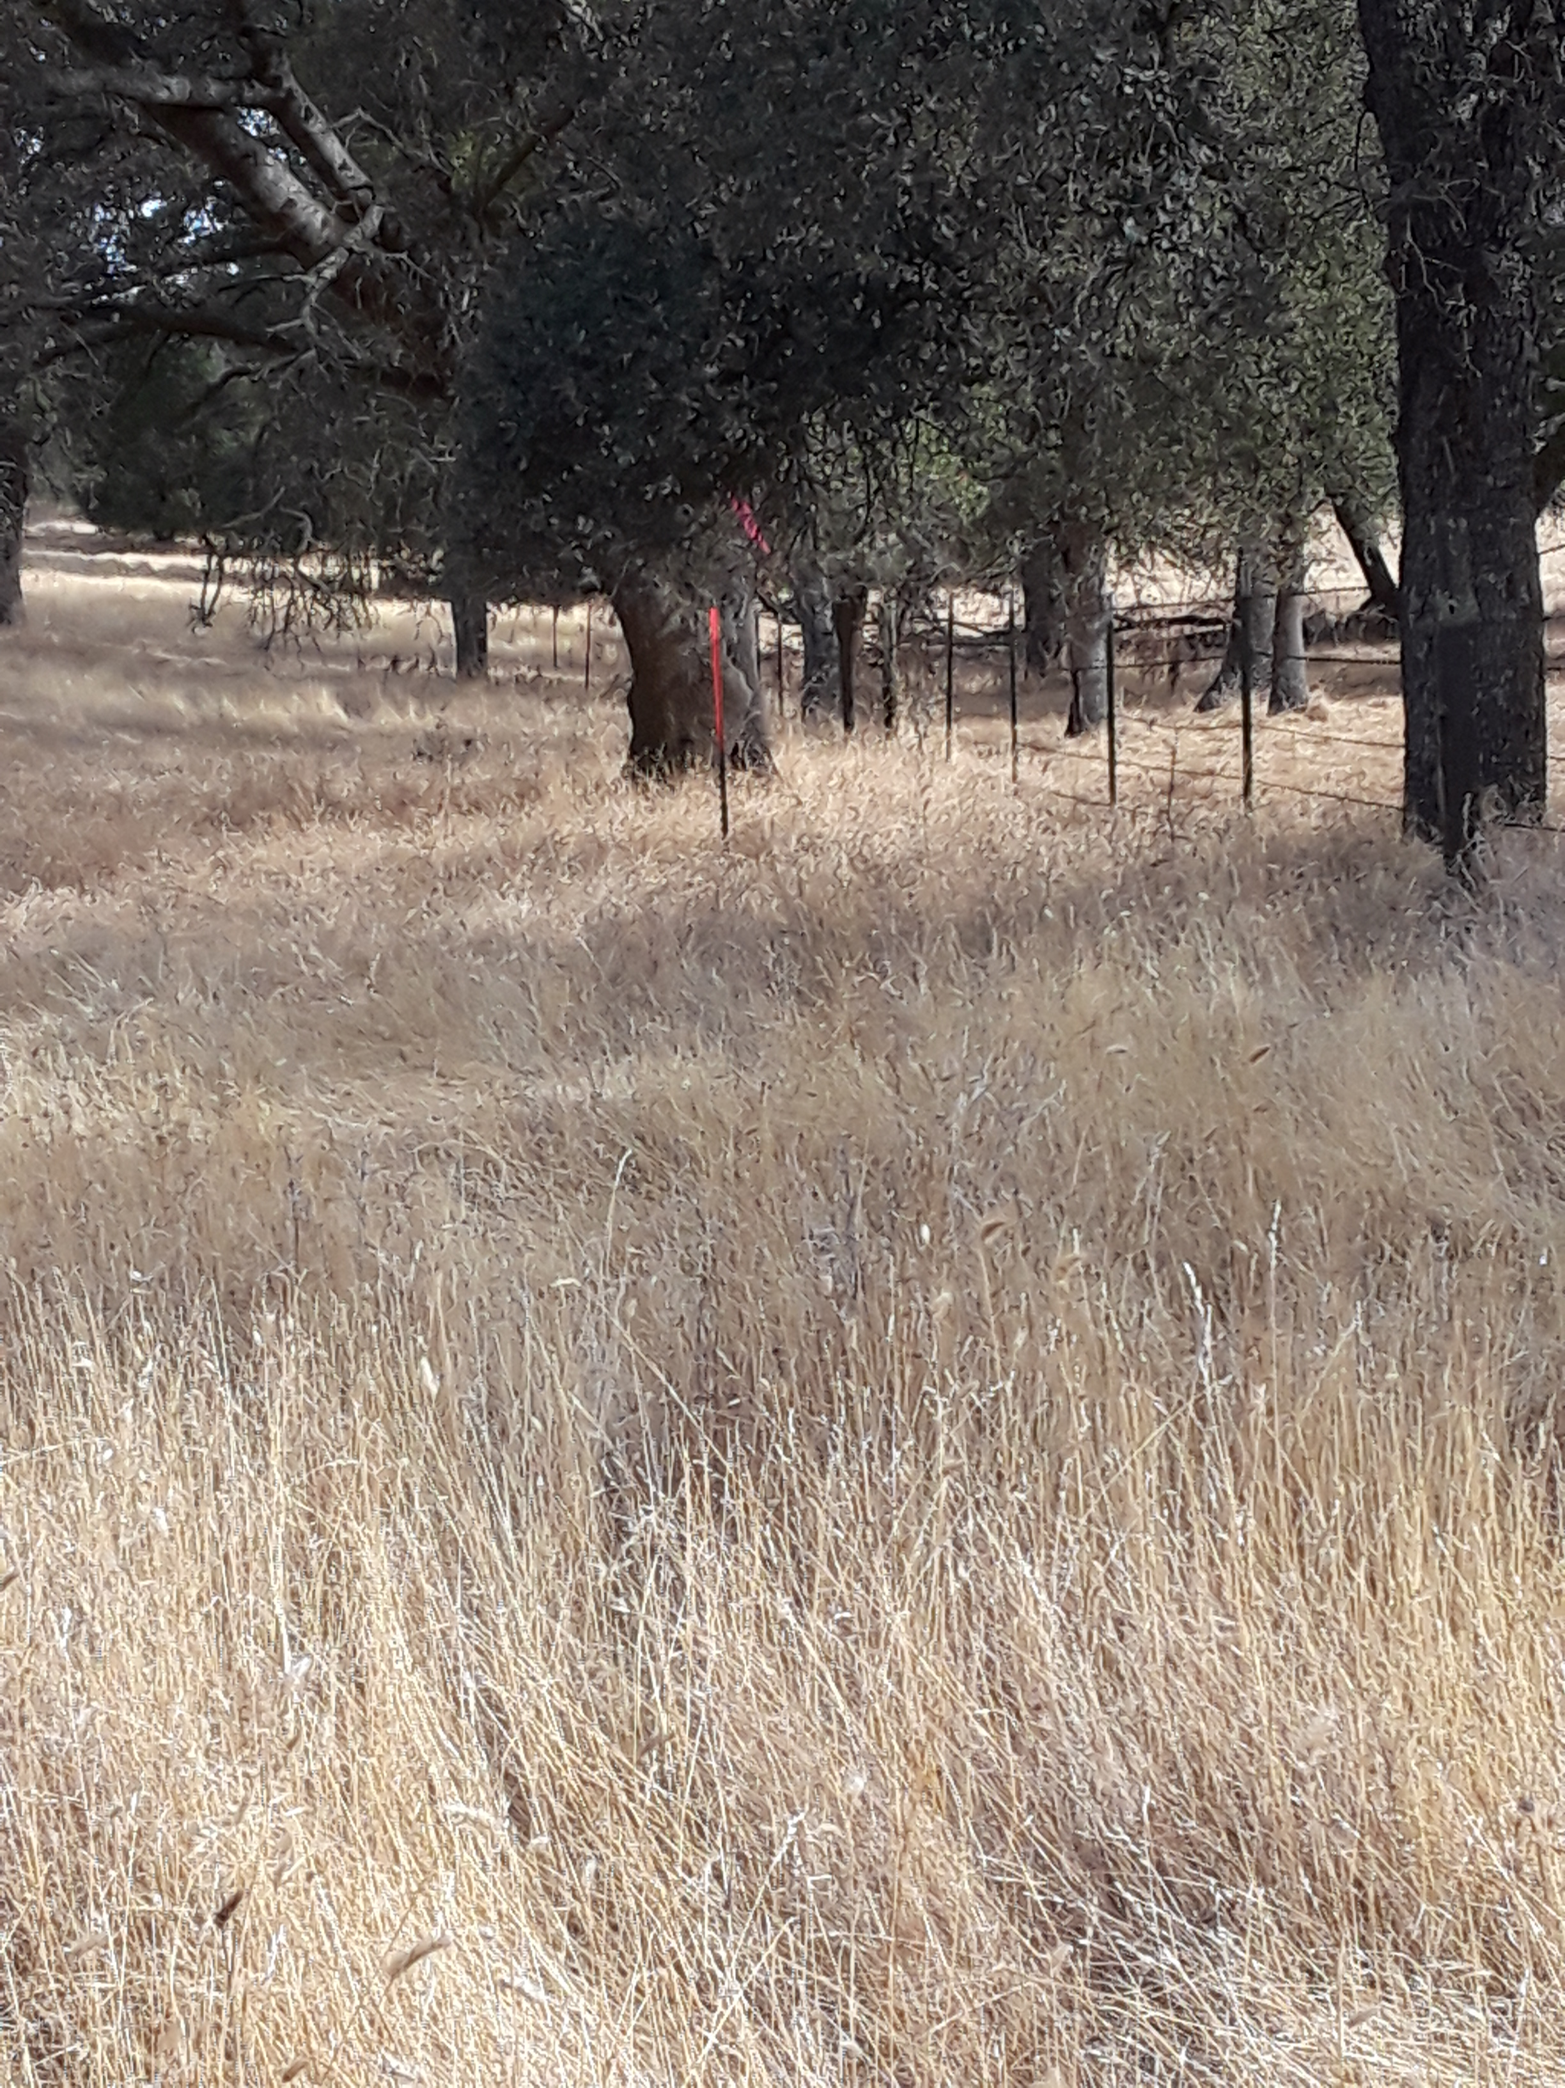

Slide 68
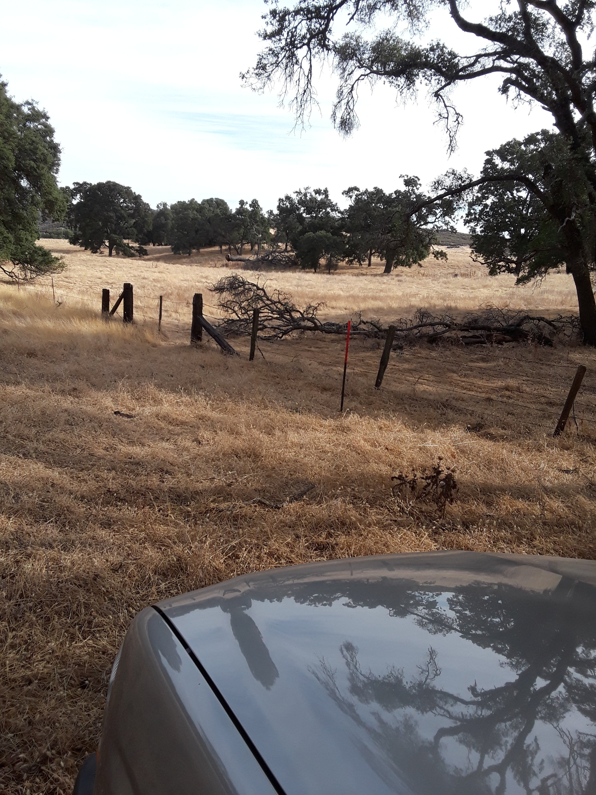

Slide 69
Point I

Slide 70
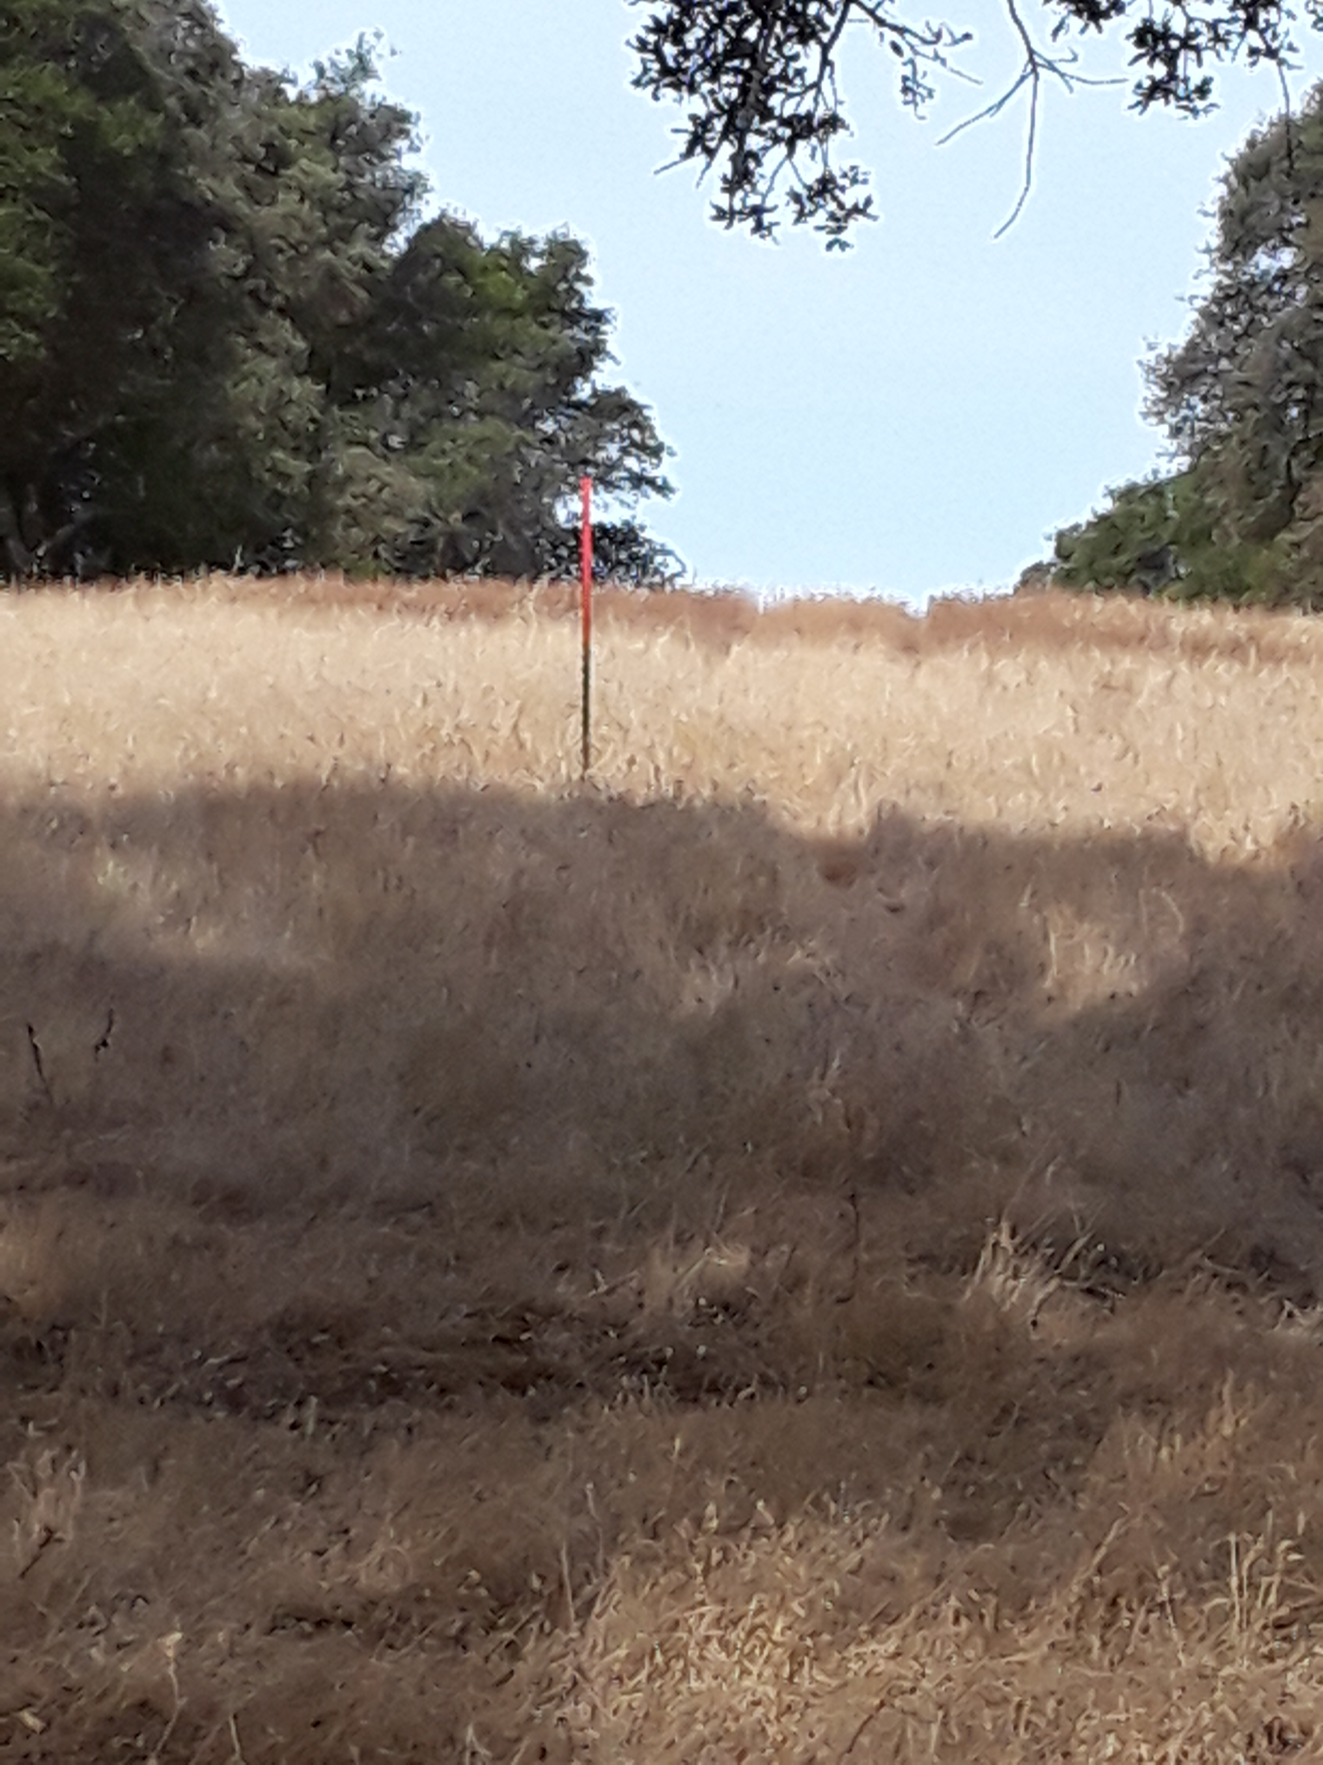

Slide 71
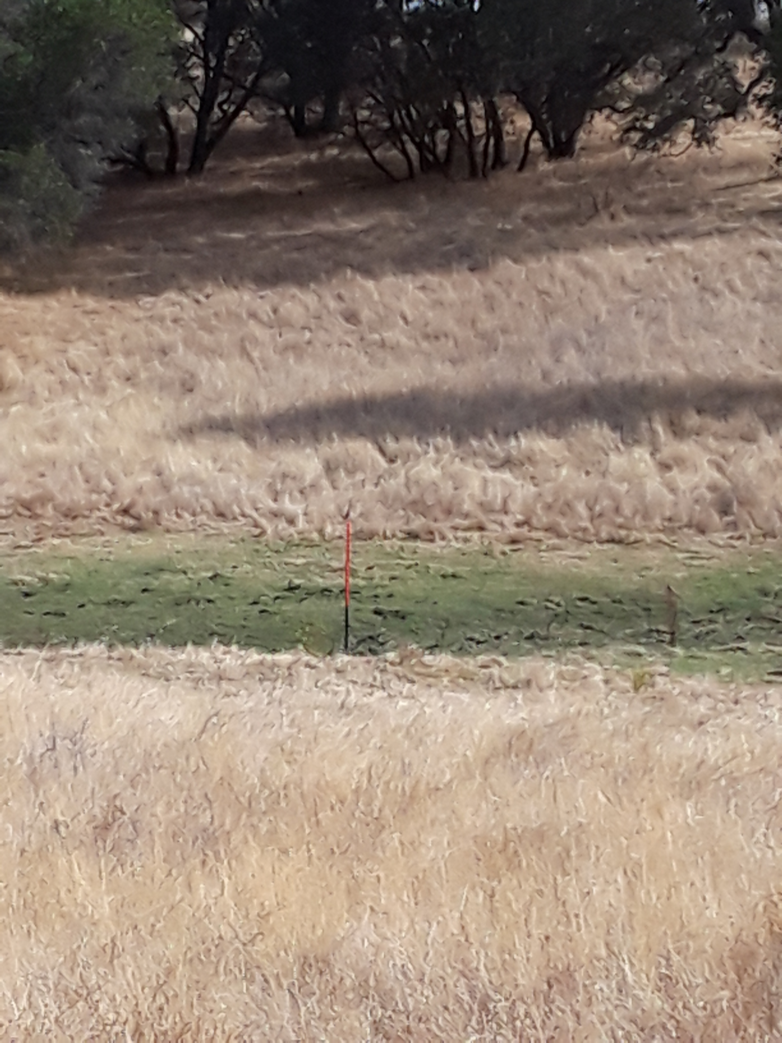

Slide 72
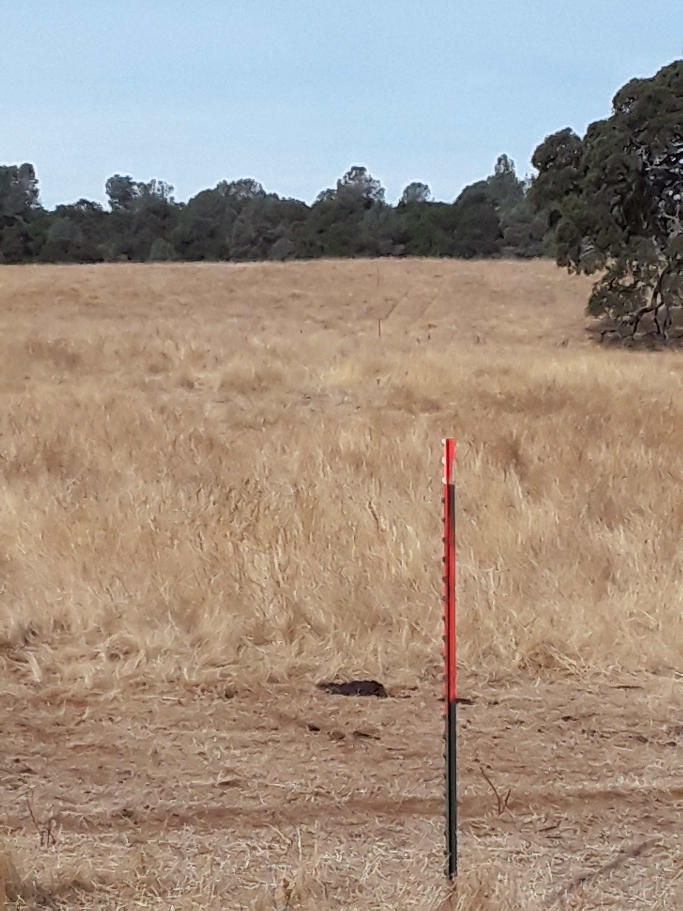

Slide 73
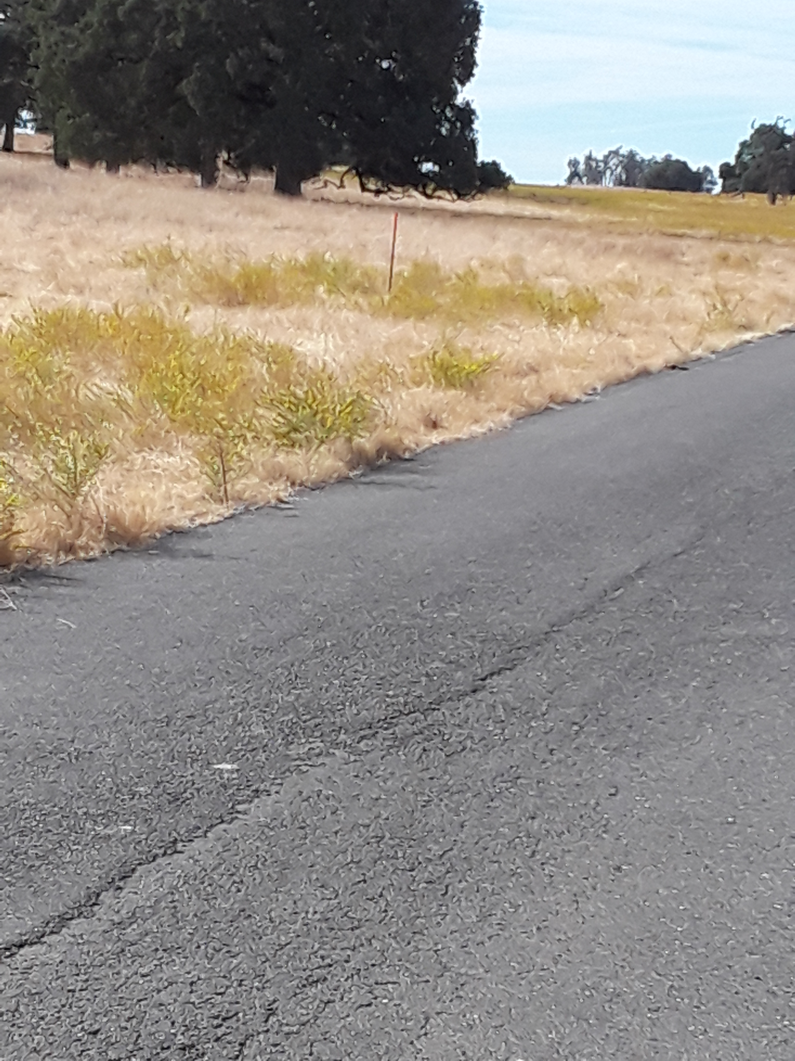

Slide 74
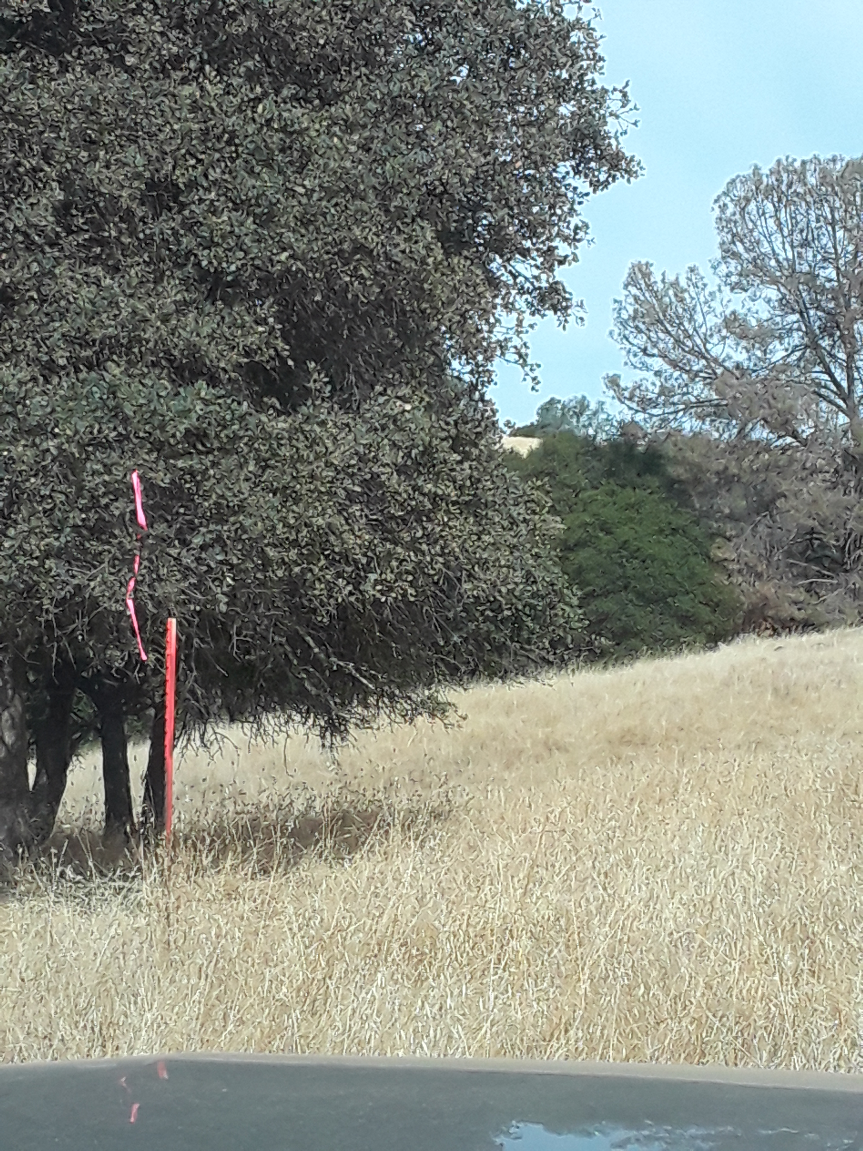

Slide 75
Line P,G,F,E,D
The following pictures follow the T post marking of line P,G,F,E,D.

Slide 76

Point P is in the center of this slide.

Slide 77


Slide 78


Slide 79


Slide 80


Slide 81


Slide 82


Slide 83


Slide 84


